Slide 1
Notes:
10.03.2020
<number>
© 2015 Microsoft Corporation. All rights reserved. Microsoft, Windows, and other product names are or may be registered trademarks and/or trademarks in the U.S. and/or other countries. The information herein is for informational purposes only and represents the current view of Microsoft Corporation as of the date of this presentation. Because Microsoft must respond to changing market conditions, it should not be interpreted to be a commitment on the part of Microsoft, and Microsoft cannot guarantee the accuracy of any information provided after the date of this presentation. MICROSOFT MAKES NO WARRANTIES, EXPRESS, IMPLIED OR STATUTORY, AS TO THE INFORMATION IN THIS PRESENTATION.
TechReady 22

Slide 2
Dev313
Dev313
Testing in Continuous Integration and Continuous Deployment
Charles Sterling
Senior Program Manager
Developer Division
Notes:
IMPORTANT NOTES:
TechReady22 will utilize Windows 10 and the new PowerPoint 2016, as well as PowerPoint 2013 on all event machines. Please build your slides utilizing the appropriate TR22 Template and utilize the version of PPT that works best.
Windows 10 does not support VPN access with a smart card reader. Phone Authentication is the only supported solution. Speakers using VPN in a demo will need to have Phone Authentication pre-configured. Additional details are available here: https://microsoft.sharepoint.com/sites/itweb/securelogon/Pages/FAQ.aspx
10.03.2020
<number>
© 2014 Microsoft Corporation. All rights reserved. Microsoft, Windows, and other product names are or may be registered trademarks and/or trademarks in the U.S. and/or other countries. The information herein is for informational purposes only and represents the current view of Microsoft Corporation as of the date of this presentation. Because Microsoft must respond to changing market conditions, it should not be interpreted to be a commitment on the part of Microsoft, and Microsoft cannot guarantee the accuracy of any information provided after the date of this presentation. MICROSOFT MAKES NO WARRANTIES, EXPRESS, IMPLIED OR STATUTORY, AS TO THE INFORMATION IN THIS PRESENTATION.

Slide 3
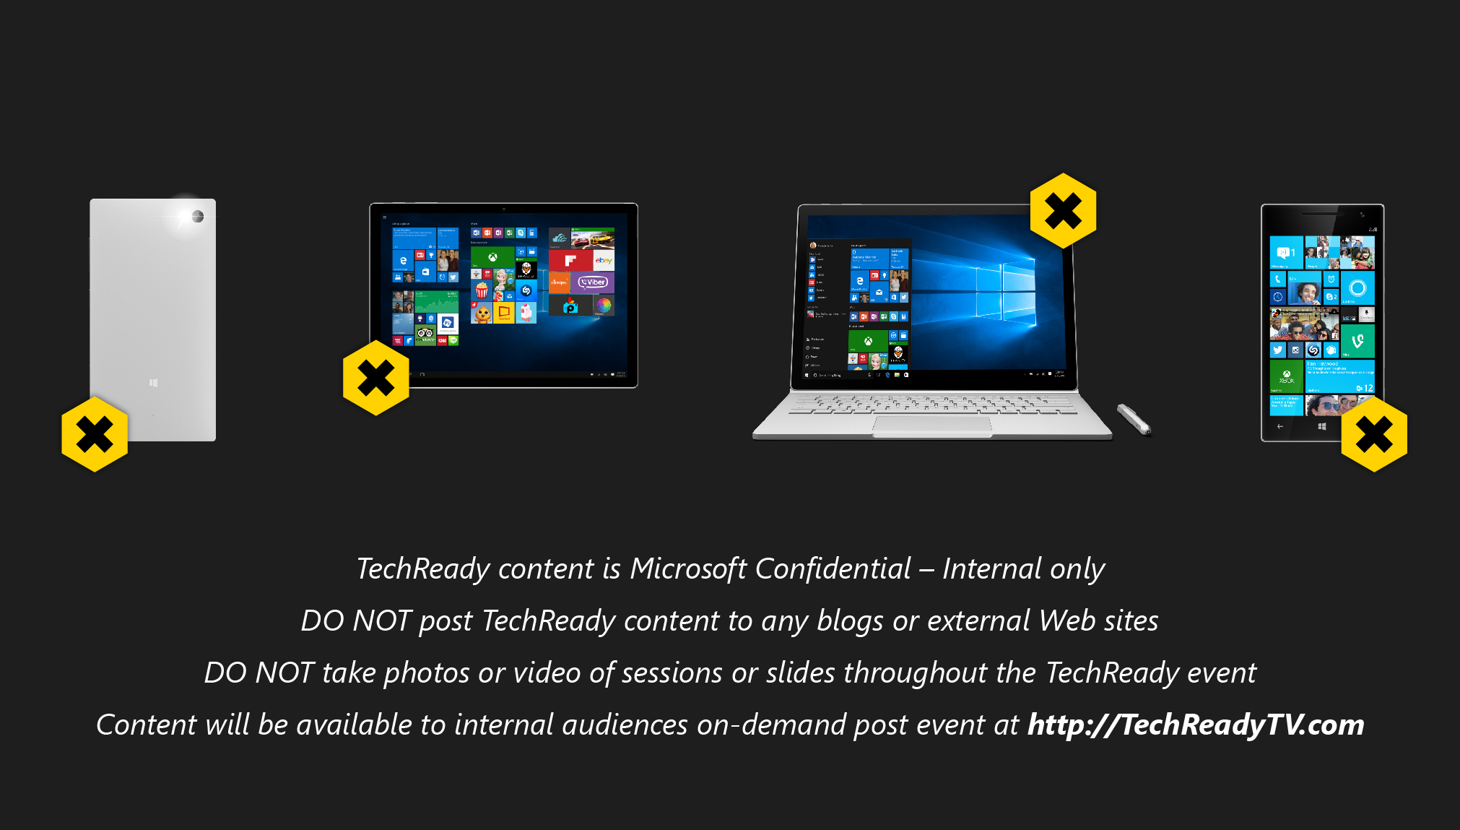
Confidentiality Slide
This slide is required. Do NOT delete or alter the slide.
Delete this text box.

Slide 4
Session Objectives
Make you successful with Testing in your CI/CD efforts
Make you successful with DEMOING Testing in your DevOps sessions
Better position TFS/Test in new/existing customer engagements
Notes:
As DevOps practices become more prevalent, it has become quite clear that Testing has become a Team sport! There are more folks manually testing the product than you can imagine: Feature teams do a bug bash, Product managers play with the product, Execs prepare for keynote demos, Business experts do User Acceptance Testing, Early adopters use the product in real world scenarios etc. We believe that it will be years before manual testing gives way to 100% automation. Everyone wants to provide feedback and improve quality of the product. Come learn about the scenarios being enabled in TFS 2015 for the Manual testing world, using live demos – export test outcome, test retention, viewing manual iterations, simplified way to perform exploratory testing of web apps, directly from the browser, etc. We will also go over the manual testing capabilities that are present in both Microsoft Test Manager & Test Hub (in team web access) and what to use when. In addition, with all the changes being made to the Visual Studio Team Services licensing, we will dig deeper into the testing scenarios of User Acceptance Testing, privileges to use the MTM client, acquisition of Test Manager extension from Visual Studio Team Services marketplace etc., from the licensing perspective. Come join me for an interactive & engaging discussion on Manual Testing and have your testing related questions answered!
Objectives
describe the roadmap for manual testing tools being enabled in TFS/VS 2015 wave
articulate to your customers the new value that is being added in Manual Testing space
better position TFS/Test in new/existing customer engagements
10.03.2020
© 2012 Microsoft Corporation. All rights reserved. Microsoft, Windows, Windows Vista and other product names are or may be registered trademarks and/or trademarks in the U.S. and/or other countries.
The information herein is for informational purposes only and represents the current view of Microsoft Corporation as of the date of this presentation. Because Microsoft must respond to changing market conditions, it should not be interpreted to be a commitment on the part of Microsoft, and Microsoft cannot guarantee the accuracy of any information provided after the date of this presentation. MICROSOFT MAKES NO WARRANTIES, EXPRESS, IMPLIED OR STATUTORY, AS TO THE INFORMATION IN THIS PRESENTATION.
<number>
Tech Ready 15

Slide 5
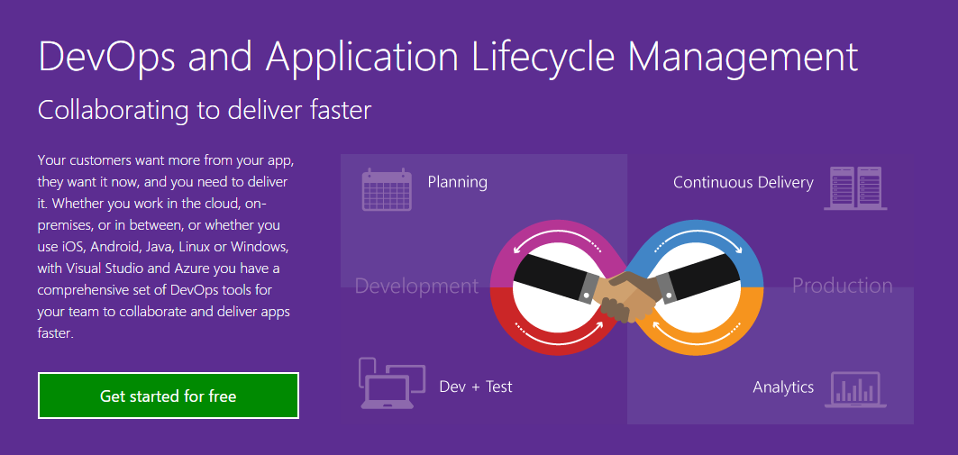
DevOps
Notes:
[Slide goal]
Introduce and define DevOps – specifically, establish what customer challenges are driving the demand for an Agility and DevOps solution
[Talk track]
Successful companies understand that competitive advantage is a transient condition, and in order to continuously innovate in an era of digitized operations, they are writing their own software.
Successful organizations see development of custom applications not as a craft that happens somewhere in a corner, disconnected from the business, but as a strategic process that generates value for the business. This leads them to see development from the perspective of a value chain where value does not materialize when outputs are delivered through requirements implementation, but when outcomes are realized through the right requirements being implemented, tested and deployed into production. More value, faster, is of course better – hence the focus on throughput/flow.
Successful organizations tend to focus on organizational aspects (people), processes and tools that help them improve the flow of value and eliminate waste, so that they can be more effective.
Successful organizations, ultimately:
Adapt and learn – requirements are refined through a quick succession of feedback loops. More conservative organizations will do this through process patterns such as specification by example (behavior driven development, acceptance testing development or, simply, agile testing, are also used as terms to describe this pattern), where the business, developers and testers collaborate closely on refining the specification and continuously check (test) that the implementation is loyal to it. This is all relevant in the context of improving quality. More mature organizations will perform this checks directly in production, by observing the reaction to features by users. Some people refer to this as hypothesis driven development; it is also known by the moniker build-measure-learn.
Shorten total cycle time. Adapting and learning as a goal informs this. Knowledge, no matter how formal the requirements and specification definition process is, is mostly tacit. For learning to happen in a meaningful way, feedback loops are better when shorter. Shorter cycle time is also directly (and quite often inversely proportional in a non-linear way) to quality; Value realized sooner (shorter lead time) is by definition higher value. Also, shorter cycles impose smaller batches of work, which in turn (as researched and documented by queuing theory) also has a positive (non-linear) effect on quality (quality, in this context, is defined as structural and functional – valuable software is more likely to manifest when executing in short cycles than in long phases).
Eliminate waste. Short cycle times demand removal of wasteful activities. Spending days promoting code to the acceptance testing environment is not conducive to fast feedback loops and shortened lead time to value. Optimized use of resources (i.e.: environment provisioning) is an attribute common in successful and high performing organizations.
Collaborate.
Reduce risk. For shortened cycle times to be sustainable, safety is necessary. Availability and resilience (or better, anti-fragility) needs to be a key attribute of the product and the process. Monitoring and diagnostics tools are typically involved with this. More mature organizations will purposely inject faults into their production environment to practice detection, diagnosis and remediation processes. Practice makes perfect.
S4 Solution Specialist Sales Summit
© 2013 Microsoft Corporation. All rights reserved. Microsoft, Windows, and other product names are or may be registered trademarks and/or trademarks in the U.S. and/or other countries. The information herein is for informational purposes only and represents the current view of Microsoft Corporation as of the date of this presentation. Because Microsoft must respond to changing market conditions, it should not be interpreted to be a commitment on the part of Microsoft, and Microsoft cannot guarantee the accuracy of any information provided after the date of this presentation. MICROSOFT MAKES NO WARRANTIES, EXPRESS, IMPLIED OR STATUTORY, AS TO THE INFORMATION IN THIS PRESENTATION.
10.3.20 01:54 PM
<number>

Slide 6
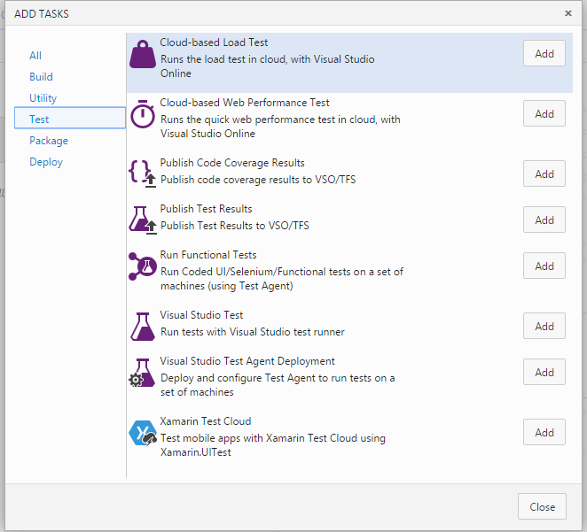
Microsoft Test Tasks (& the Agenda)
Visual Studio
Run Functional Test
Load Test
Notes:
Close
© 2015 Microsoft Corporation. All rights reserved. Microsoft, Windows, and other product names are or may be registered trademarks and/or trademarks in the U.S. and/or other countries. The information herein is for informational purposes only and represents the current view of Microsoft Corporation as of the date of this presentation. Because Microsoft must respond to changing market conditions, it should not be interpreted to be a commitment on the part of Microsoft, and Microsoft cannot guarantee the accuracy of any information provided after the date of this presentation. MICROSOFT MAKES NO WARRANTIES, EXPRESS, IMPLIED OR STATUTORY, AS TO THE INFORMATION IN THIS PRESENTATION.
10.03.2020
<number>

Slide 7
Microsoft Testing Tasks
Task Type
Agent
Execution
Reporting
Visual Studio Test
Build Agent
Where ever your Build Agent is
Build Summary/Test Runs
Load Test
Cloud-based load test agent
Hosted
“Local” SQL/Visual Studio
Run Functional Test
BYO
“Your Machines”
Build Summary/Test Runs
Notes:
© 2015 Microsoft Corporation. All rights reserved. Microsoft, Windows, and other product names are or may be registered trademarks and/or trademarks in the U.S. and/or other countries. The information herein is for informational purposes only and represents the current view of Microsoft Corporation as of the date of this presentation. Because Microsoft must respond to changing market conditions, it should not be interpreted to be a commitment on the part of Microsoft, and Microsoft cannot guarantee the accuracy of any information provided after the date of this presentation. MICROSOFT MAKES NO WARRANTIES, EXPRESS, IMPLIED OR STATUTORY, AS TO THE INFORMATION IN THIS PRESENTATION.
10.03.2020
<number>

Slide 8
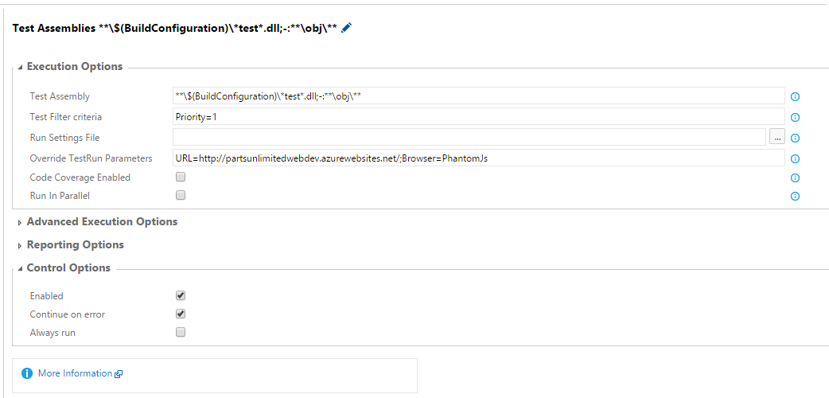
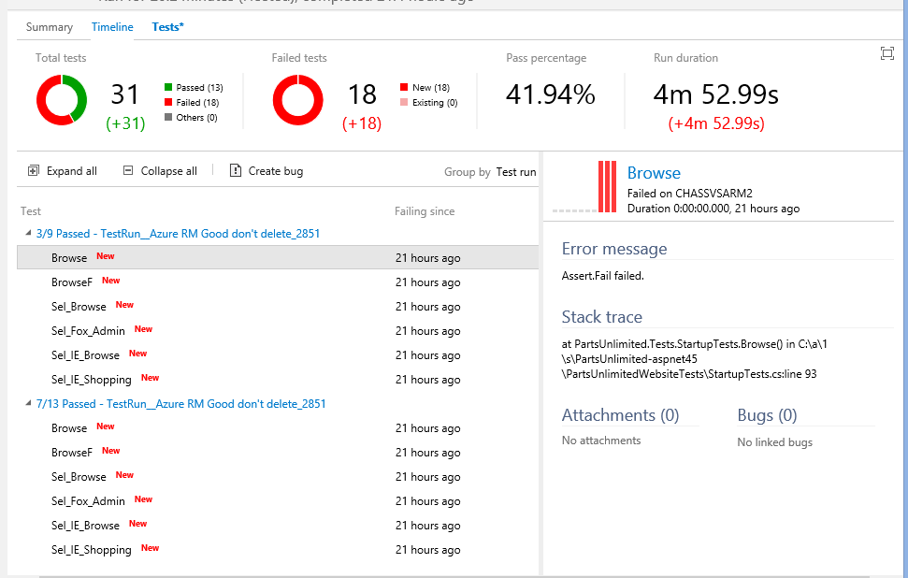
Visual Studio Test Task
Notes:
© 2015 Microsoft Corporation. All rights reserved. Microsoft, Windows, and other product names are or may be registered trademarks and/or trademarks in the U.S. and/or other countries. The information herein is for informational purposes only and represents the current view of Microsoft Corporation as of the date of this presentation. Because Microsoft must respond to changing market conditions, it should not be interpreted to be a commitment on the part of Microsoft, and Microsoft cannot guarantee the accuracy of any information provided after the date of this presentation. MICROSOFT MAKES NO WARRANTIES, EXPRESS, IMPLIED OR STATUTORY, AS TO THE INFORMATION IN THIS PRESENTATION.
10.03.2020
<number>

Slide 9

DEMO: Visual Studio Test Agent Task
Notes:
https://blogs.msdn.microsoft.com/visualstudioalm/2016/01/27/getting-started-with-selenium-testing-in-a-continuous-integration-pipeline-with-visual-studio/
namespace Partsunlimited.UITests
{ using Microsoft.VisualStudio.TestTools.UnitTesting; using OpenQA.Selenium; using OpenQA.Selenium.Chrome; using OpenQA.Selenium.Firefox; using OpenQA.Selenium.IE; using OpenQA.Selenium.Remote; using OpenQA.Selenium.PhantomJS; using System;
[TestClass] public class ChucksClass1 { private string baseURL = “http://partsunlimited.azurewebsites.net/”; private RemoteWebDriver driver; private string browser; public TestContext TestContext { get; set; }
[TestMethod] [TestCategory(“Selenium”)] [Priority(19)] [Owner(“FireFox”)] //Using Owner as Category trait is not supported by the DTA Task public void RemoteSelenium() { DesiredCapabilities capability = DesiredCapabilities.Firefox(); Uri server = new Uri(“http://<YourGridserver>:80/wd/hub”); this.driver = new RemoteWebDriver(server, capability); driver.Manage().Window.Maximize(); driver.Navigate().GoToUrl(this.baseURL); driver.FindElementById(“search-box”).Clear(); driver.FindElementById(“search-box”).SendKeys(“tire”); //do other Selenium things here! }
[TestMethod] [TestCategory(“Selenium”)] [Priority(5)] [Owner(“BuildSet”)] //Using Owner as Category trait is not supported by the DTA Task public void TireSearch_Any() { driver.Manage().Window.Maximize(); driver.Manage().Timeouts().ImplicitlyWait(TimeSpan.FromSeconds(30)); driver.Navigate().GoToUrl(this.baseURL); driver.FindElementById(“search-box”).Clear(); driver.FindElementById(“search-box”).SendKeys(“tire”); //do other Selenium things here! }
/// <summary> /// Use TestCleanup to run code after each test has run /// </summary> [TestCleanup()] public void MyTestCleanup() { driver.Quit(); }
[TestInitialize()] public void MyTestInitialize() { //Set the browswer from a build browser = this.TestContext.Properties[“browser”] != null ? this.TestContext.Properties[“browser”].ToString() : “firefox”; switch (browser) { case “firefox”: driver = new FirefoxDriver(); break; case “chrome”: driver = new ChromeDriver(); break; case “ie”: driver = new InternetExplorerDriver(); break; case “PhantomJS”: driver = new PhantomJSDriver(); break; default: driver = new PhantomJSDriver(); break; } if (this.TestContext.Properties[“Url”] != null) //Set URL from a build { this.baseURL = this.TestContext.Properties[“Url”].ToString(); } else { this.baseURL = “http://partsunlimited.azurewebsites.net/”; //default URL just to get started with } } } }
<number>

Slide 10
Run Functional Tests
Copy files to test computers
Filter Tests to be run/Execution
Deploy the Test Agent & configure Machines
Notes:
<number>

Slide 11
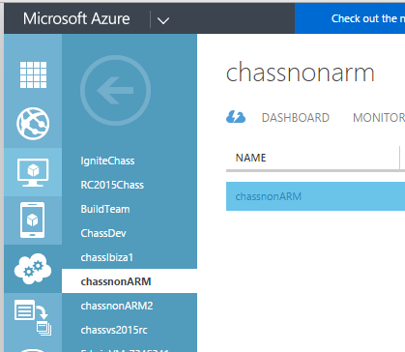
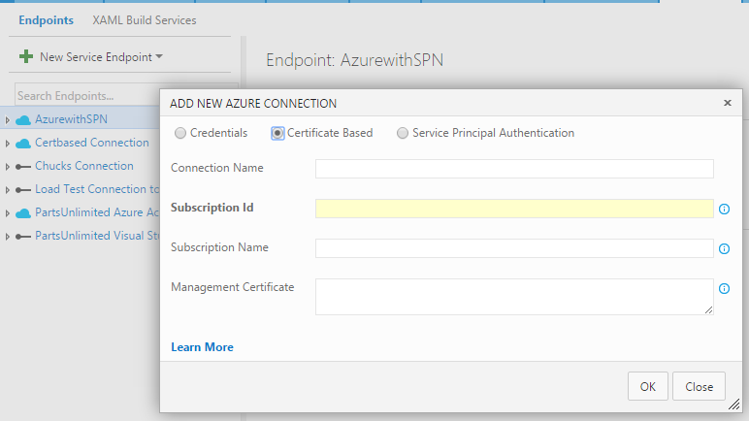
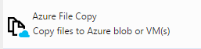

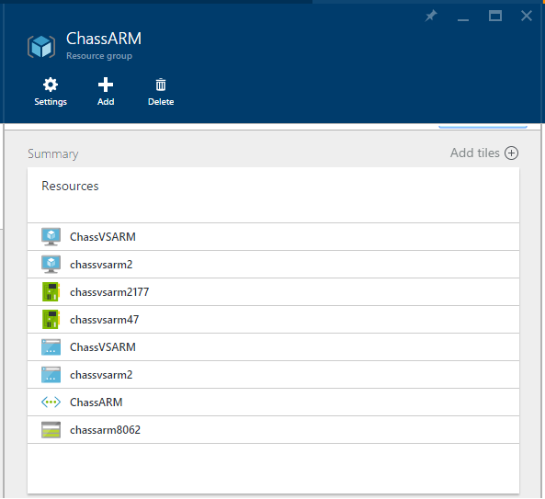
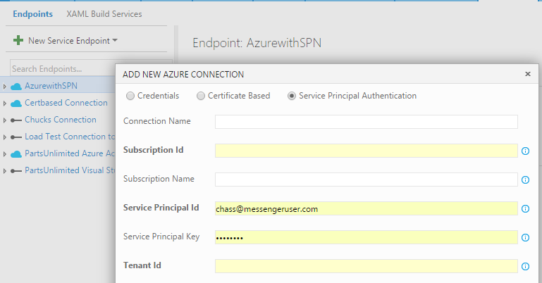
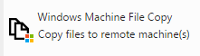
Copy files to test computers
Classic Azure
Virtual Machines
None Azure based Machines
Service
Connections
Modern Azure
Virtual Machines
Copying files
Notes:
<number>

Slide 12
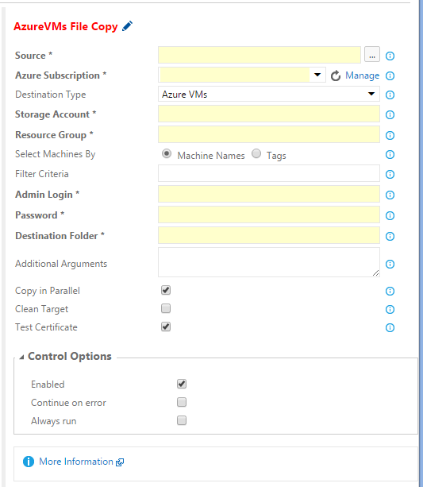
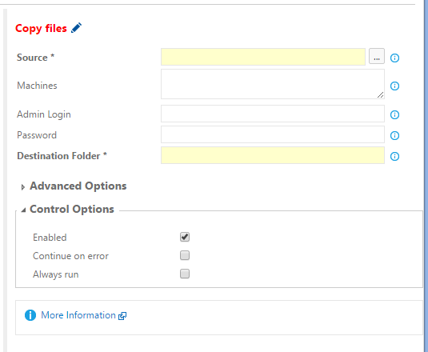
Copy files to test computers
Classic Azure
Virtual Machines
Requires
Creating SPN
Network with SSL
Configure WinRM over SSL
None Azure based Machines
Modern Azure
Virtual Machines
Copying files
Notes:
https://gist.github.com/sjkp/186d36334b27656a05cd (one pages)
https://github.com/Azure/azure-quickstart-templates/blob/master/201-vm-winrm-windows/winrmconf.cmd
https://github.com/Azure/azure-quickstart-templates/blob/master/201-vm-winrm-windows/makecert.exe
https://github.com/Azure/azure-quickstart-templates/blob/master/201-vm-winrm-windows/ConfigureWinRM.ps1 (two pages)
<number>

Slide 13
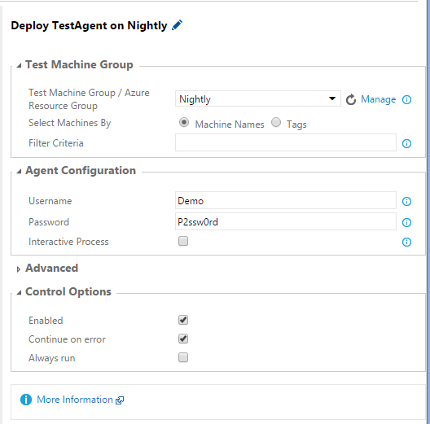
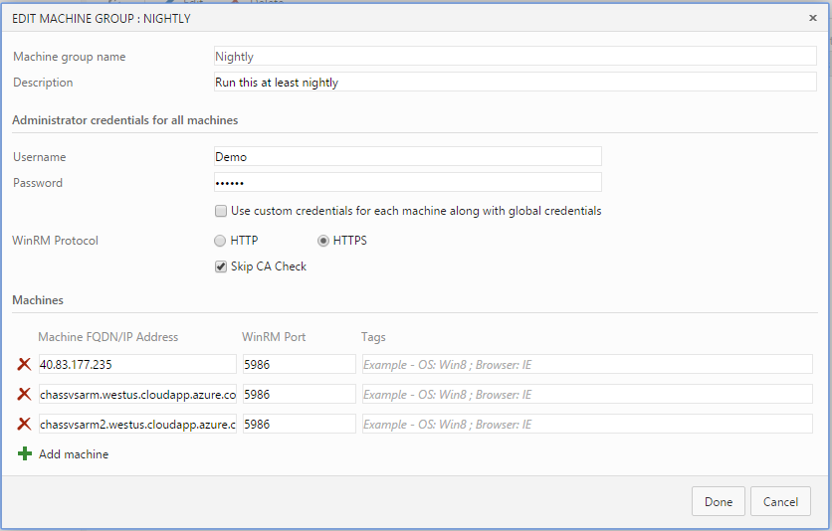
Nightly
Test
Filtering &
Execution
Deploy the Test Agent & configure Machines
BVT
Accessibility
Deploying/Configuring The Test Agent
Notes:
<number>

Slide 14
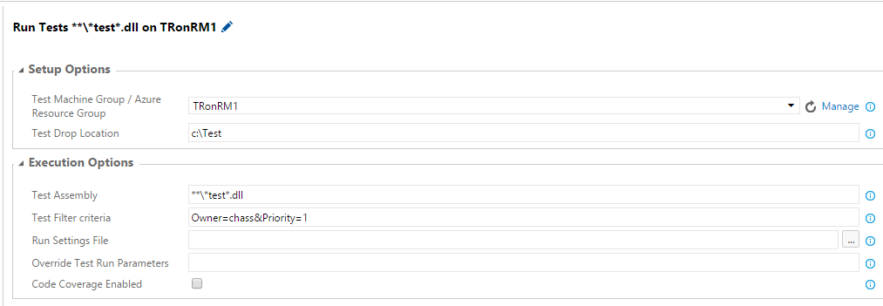
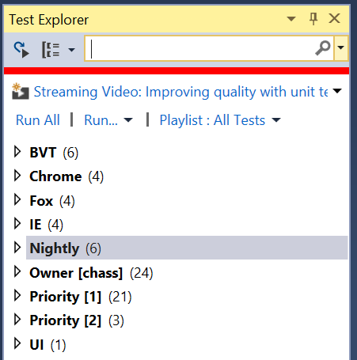
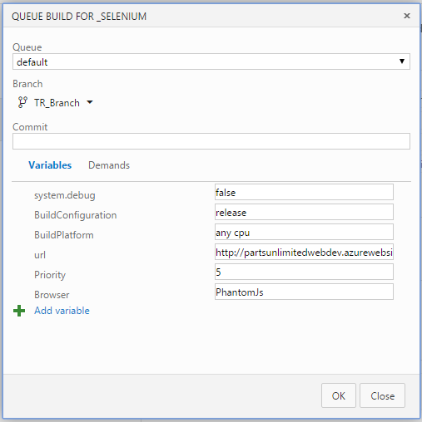
Nightly
Set in Definition
Select and Execute Tests
Unit Tests
Owner/BVT
Accessibility
Set at Queue
Owner/Nightly
Filtering and Execution
Notes:
Since the run Functional Test task doesn’t support traits like BVT or Nightly you will need to use Priority or Owner to factor your test execution
<number>

Slide 15
DEMO: Run Functional Test Task
Notes:
1. Test Any App
2. Functional > Selenium X Browser
3. CI/CD Integration
<number>

Slide 16
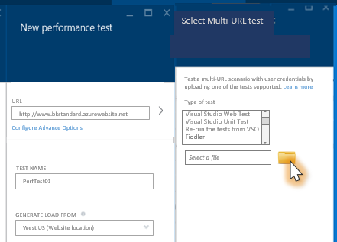
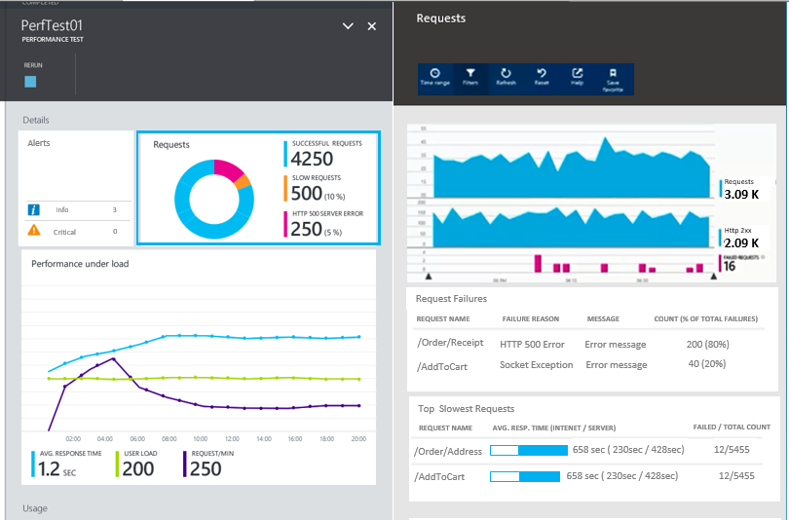
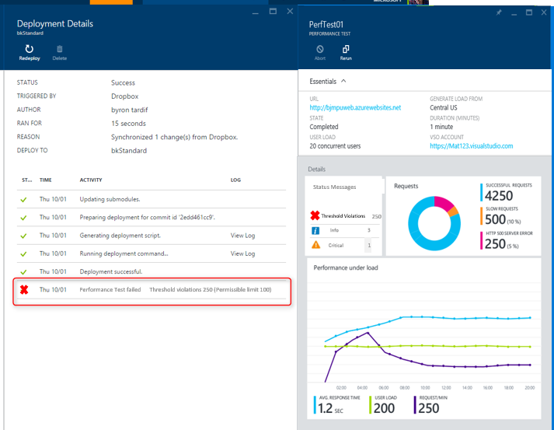
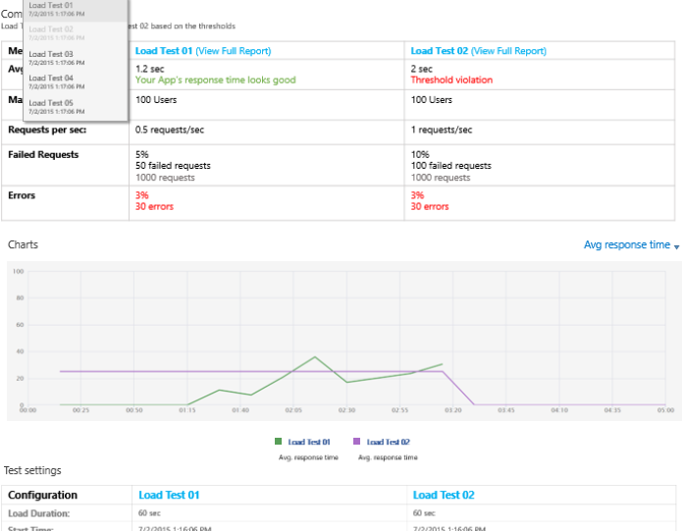
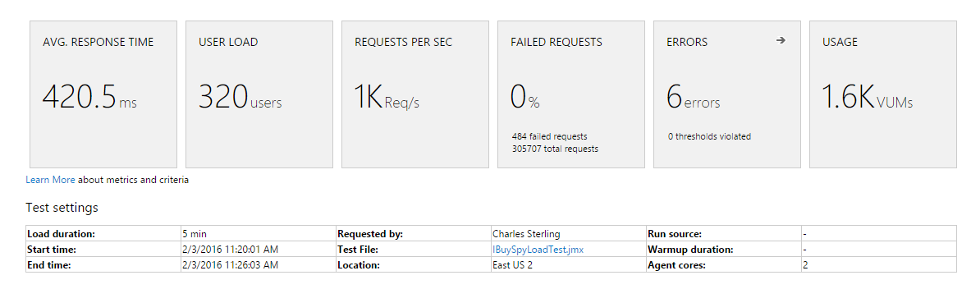
What is Next for Load Test?
Load Test Authoring Import (For both Azure and VSTS)
Fiddler *Visual Studio Unit Tests
Re-run VSTS *Visual Studio Web Tests * Jmeter
APM Integration
Application Insights Integration
New Relic Onboarding
Continuous Deployment with Kudu
Visual Studio Team Services * Bitbucket *External Repository
Dropbox * OneDrive *Github * Local Git repository
Load Test Manager in Visual Studio Team Services
Visual Studio Team Services
Jmeter
* Import/Run *Offline Analysis
* Web based Reports *Jmeter IDE integration (+All the load test value: Scale, geographies)
Notes:
<number>

Slide 17
DEMO: Cloud-based Load Test in CI
Notes:
1. Test Any App
2. Functional > Selenium X Browser
3. CI/CD Integration
<number>

Slide 18
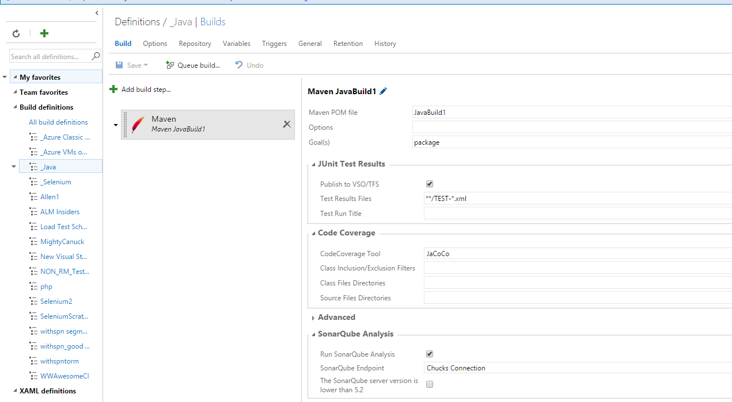
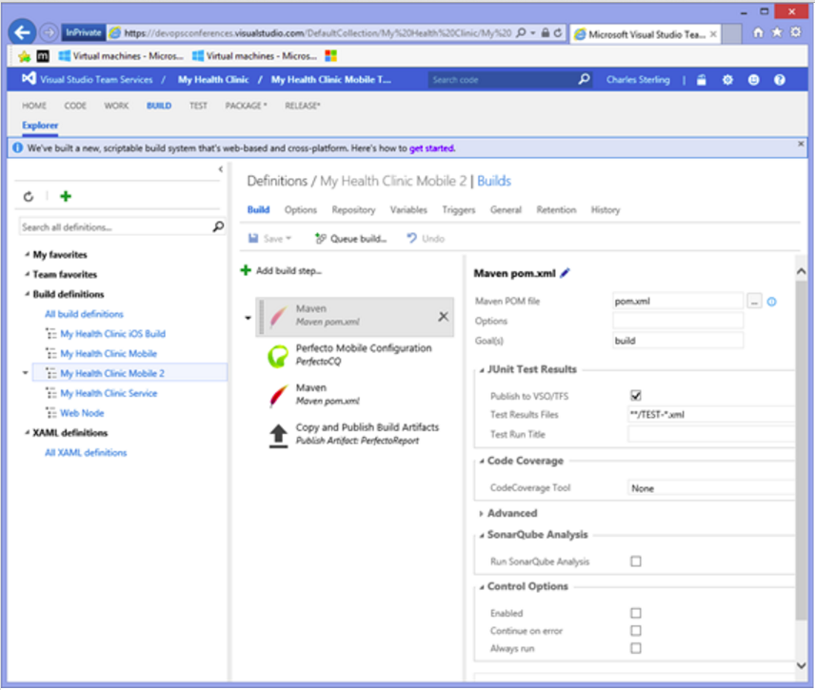
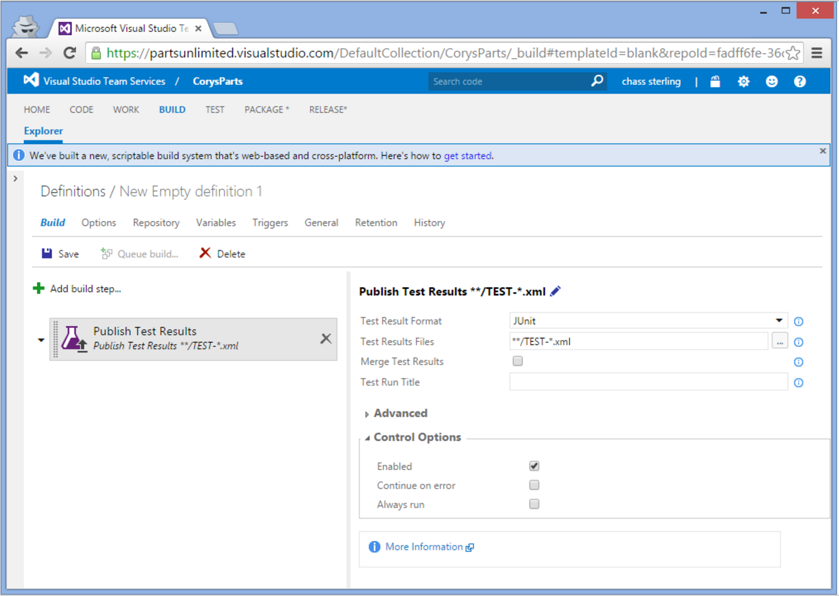

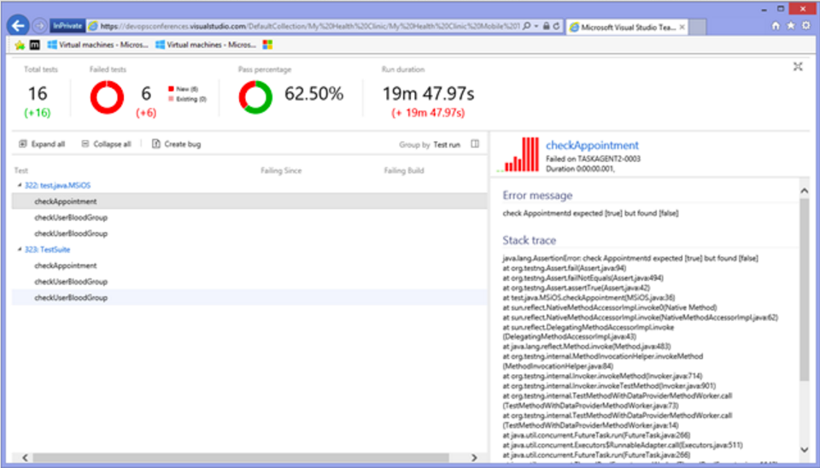
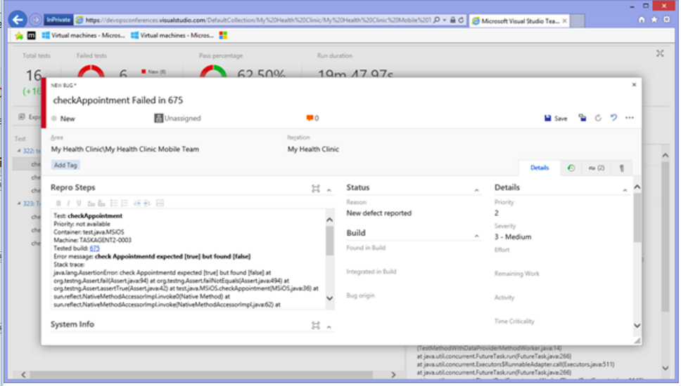
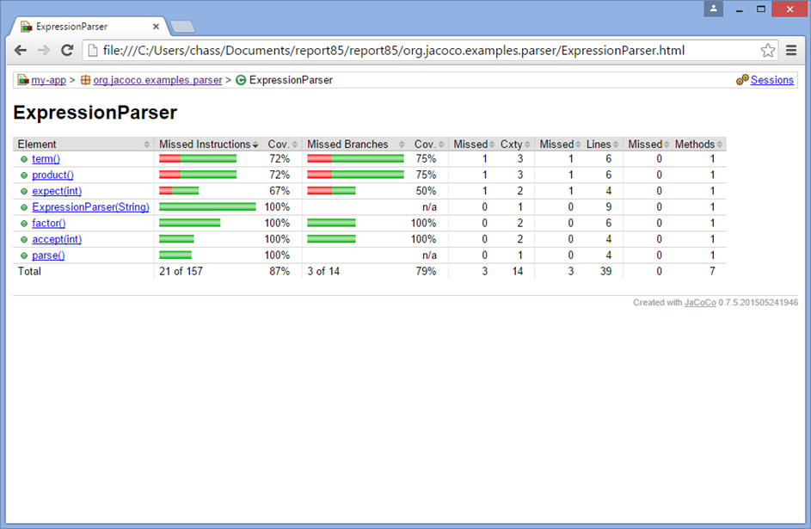
Testing Java Applications
The Bonus Test
Task!!!
Maven Task can automatically execute and publish your Junit results
Publish Task enables direct publishing of the Java Results
Test Results Report will show Java errors and calls stacks for errors
Rich actionable bugs
Perform deep analytics with automatic Code Coverage Results
Notes:
<number>

Slide 19
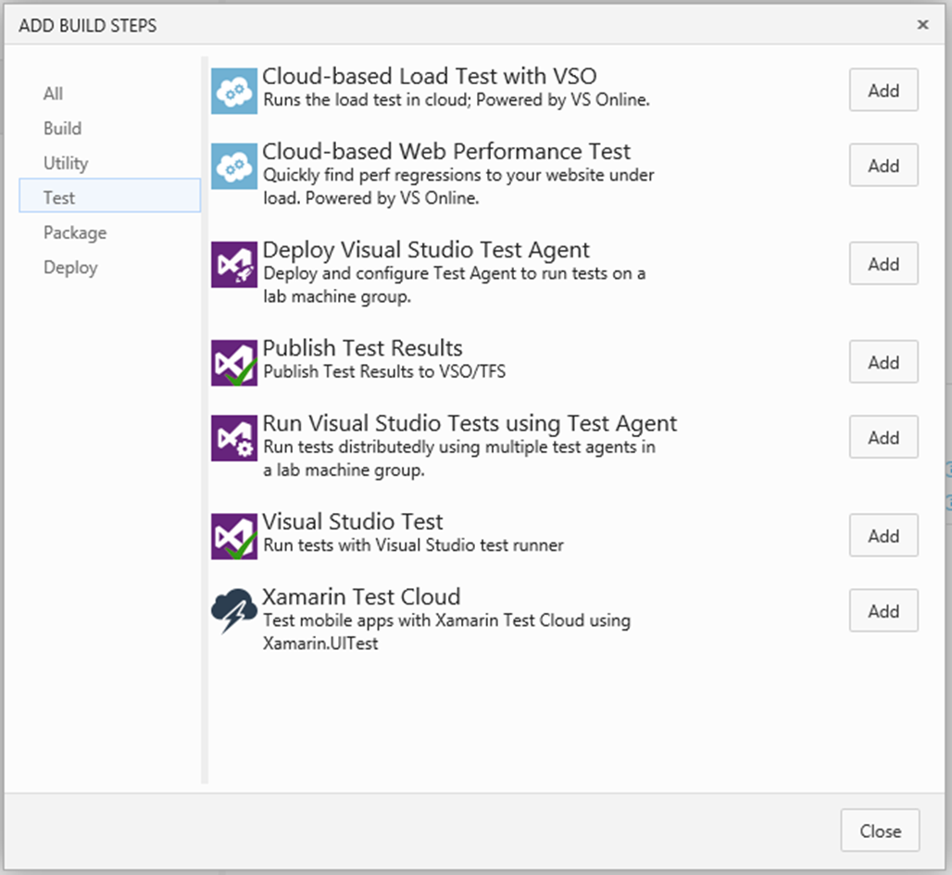
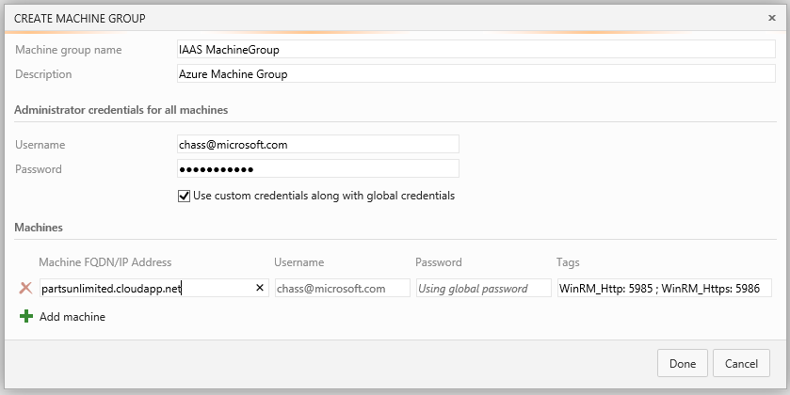
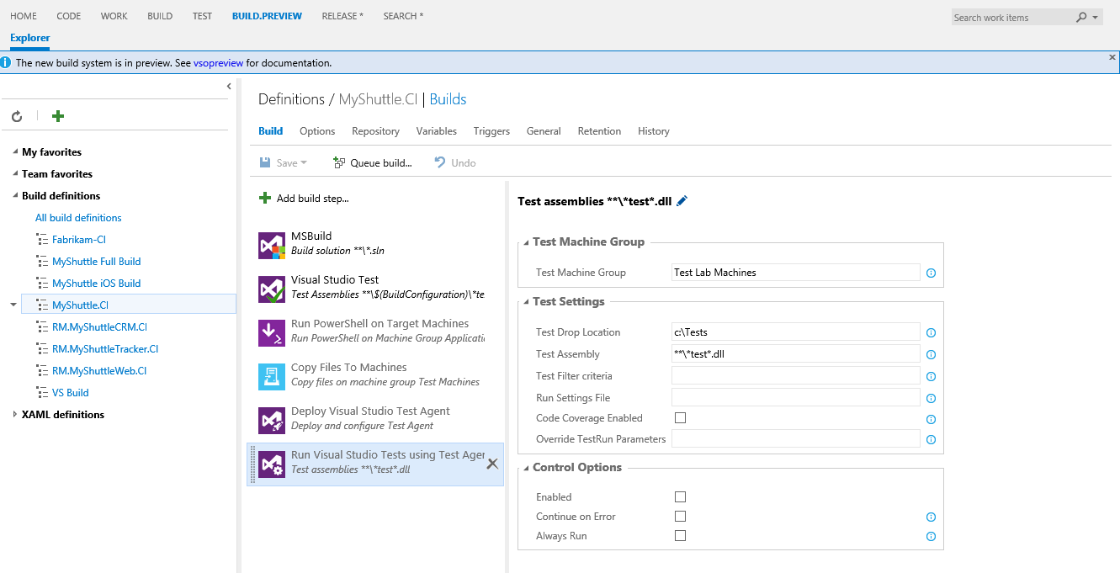
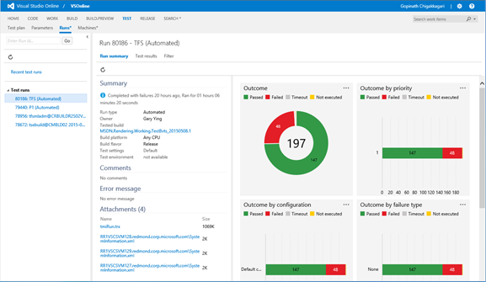
Testing in Continuous Integration “Recap”
Run tests of your choice (Unit, Functional, Junit, CodedUI, Selenium...etc)
Simplified provisioning and deploying experience
Shared/common architecture with Build(CI) and Release Management(CDP)
Local, Distributed and Load Test Execution
Rich test reports for summary
Measure Code Coverage
Drill down in to test results and analyze test failures
Notes:
1. Test Any App
2. Functional > Selenium X Browser
3. CI/CD Integration
© 2014 Microsoft Corporation. All rights reserved. Microsoft, Windows, and other product names are or may be registered trademarks and/or trademarks in the U.S. and/or other countries. The information herein is for informational purposes only and represents the current view of Microsoft Corporation as of the date of this presentation. Because Microsoft must respond to changing market conditions, it should not be interpreted to be a commitment on the part of Microsoft, and Microsoft cannot guarantee the accuracy of any information provided after the date of this presentation. MICROSOFT MAKES NO WARRANTIES, EXPRESS, IMPLIED OR STATUTORY, AS TO THE INFORMATION IN THIS PRESENTATION.
10.03.2020
<number>

Slide 20
Thank you!

Slide 21



DevOps
The agile methodologies are accelerating the construction process
Requirements
Backlog
Application Monitoring determines the next set of priorities and based on customer usage and code behaviors
Development
Production
Collaboration
Continuous Integration reduces rework and unnecessary churn in the integration process
Continuous delivery enables high quality delivery to match the pace of development with full traceability
Continuous Testing enables finding availability and performance issues with Cloud based infrastructure
Notes:
[Slide goal]
Introduce and define DevOps – specifically, establish what customer challenges are driving the demand for an Agility and DevOps solution
[Talk track]
Successful companies understand that competitive advantage is a transient condition, and in order to continuously innovate in an era of digitized operations, they are writing their own software.
Successful organizations see development of custom applications not as a craft that happens somewhere in a corner, disconnected from the business, but as a strategic process that generates value for the business. This leads them to see development from the perspective of a value chain where value does not materialize when outputs are delivered through requirements implementation, but when outcomes are realized through the right requirements being implemented, tested and deployed into production. More value, faster, is of course better – hence the focus on throughput/flow.
Successful organizations tend to focus on organizational aspects (people), processes and tools that help them improve the flow of value and eliminate waste, so that they can be more effective.
Successful organizations, ultimately:
Adapt and learn – requirements are refined through a quick succession of feedback loops. More conservative organizations will do this through process patterns such as specification by example (behavior driven development, acceptance testing development or, simply, agile testing, are also used as terms to describe this pattern), where the business, developers and testers collaborate closely on refining the specification and continuously check (test) that the implementation is loyal to it. This is all relevant in the context of improving quality. More mature organizations will perform this checks directly in production, by observing the reaction to features by users. Some people refer to this as hypothesis driven development; it is also known by the moniker build-measure-learn.
Shorten total cycle time. Adapting and learning as a goal informs this. Knowledge, no matter how formal the requirements and specification definition process is, is mostly tacit. For learning to happen in a meaningful way, feedback loops are better when shorter. Shorter cycle time is also directly (and quite often inversely proportional in a non-linear way) to quality; Value realized sooner (shorter lead time) is by definition higher value. Also, shorter cycles impose smaller batches of work, which in turn (as researched and documented by queuing theory) also has a positive (non-linear) effect on quality (quality, in this context, is defined as structural and functional – valuable software is more likely to manifest when executing in short cycles than in long phases).
Eliminate waste. Short cycle times demand removal of wasteful activities. Spending days promoting code to the acceptance testing environment is not conducive to fast feedback loops and shortened lead time to value. Optimized use of resources (i.e.: environment provisioning) is an attribute common in successful and high performing organizations.
Collaborate.
Reduce risk. For shortened cycle times to be sustainable, safety is necessary. Availability and resilience (or better, anti-fragility) needs to be a key attribute of the product and the process. Monitoring and diagnostics tools are typically involved with this. More mature organizations will purposely inject faults into their production environment to practice detection, diagnosis and remediation processes. Practice makes perfect.
S4 Solution Specialist Sales Summit
© 2013 Microsoft Corporation. All rights reserved. Microsoft, Windows, and other product names are or may be registered trademarks and/or trademarks in the U.S. and/or other countries. The information herein is for informational purposes only and represents the current view of Microsoft Corporation as of the date of this presentation. Because Microsoft must respond to changing market conditions, it should not be interpreted to be a commitment on the part of Microsoft, and Microsoft cannot guarantee the accuracy of any information provided after the date of this presentation. MICROSOFT MAKES NO WARRANTIES, EXPRESS, IMPLIED OR STATUTORY, AS TO THE INFORMATION IN THIS PRESENTATION.
10.3.20 01:54 PM
<number>

Slide 22
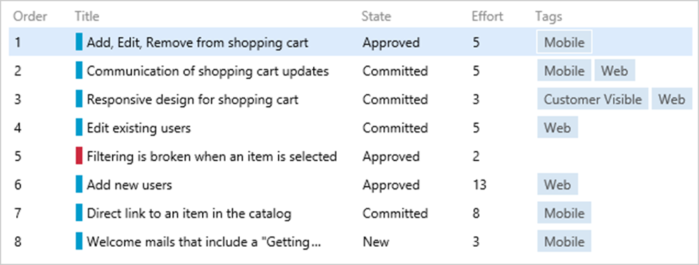
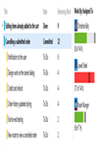
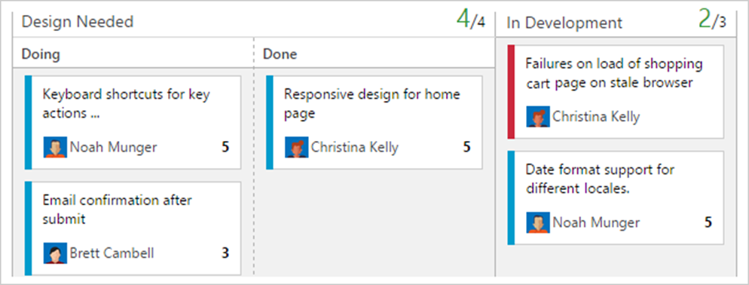
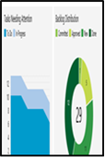
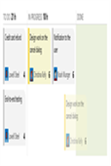
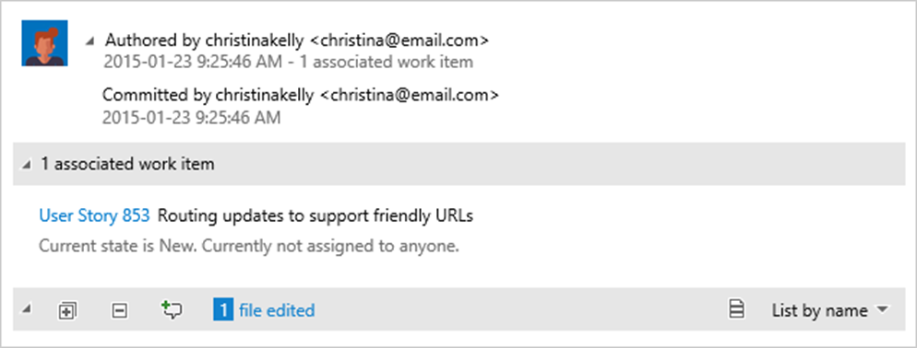
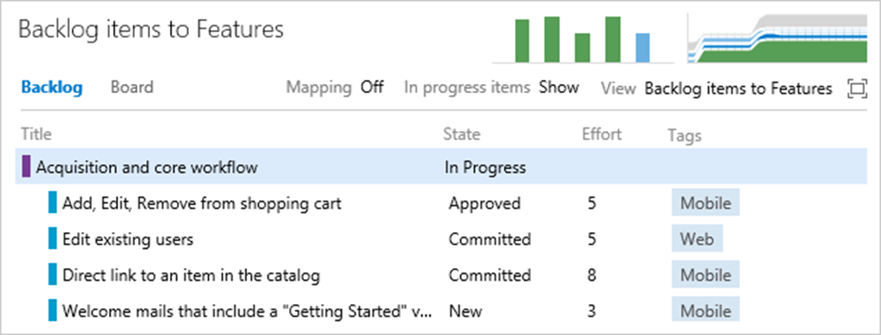
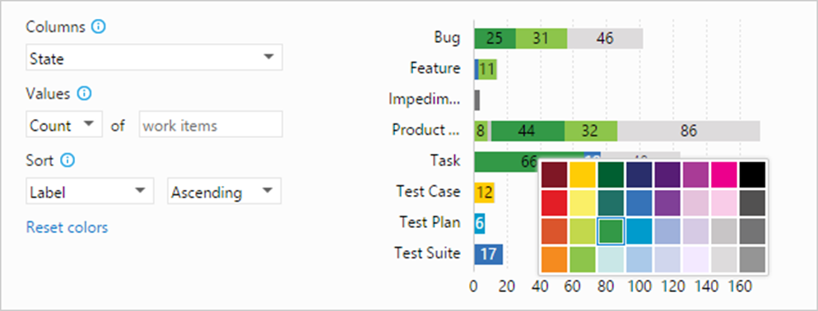
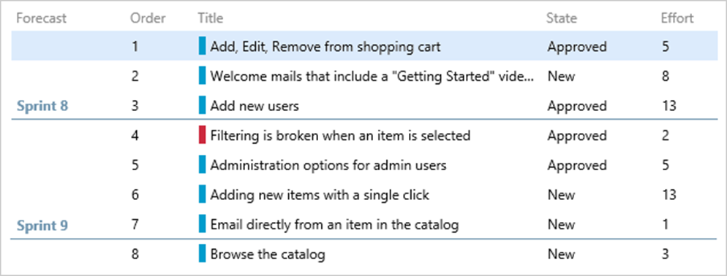
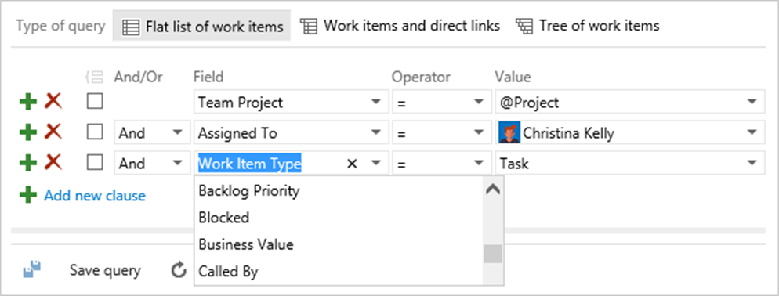
Agile Planning with Team Foundation Server
Groom, Prioritize, Align your Backlogs
Groom, Estimate, Execute with SCRUM
Monitor flow and visualize work with Kanban
Bring Together the Essentials with Dashboards
Enable better Stand-Ups with Task Boards
Traceability and Visibility of code changes
Map your backlog to business scenarios
Charts giving visibility into What Matters
Look Ahead with Confidence
Queries that let you Keep Track of Everything
Notes:
© 2014 Microsoft Corporation. All rights reserved. Microsoft, Windows, and other product names are or may be registered trademarks and/or trademarks in the U.S. and/or other countries. The information herein is for informational purposes only and represents the current view of Microsoft Corporation as of the date of this presentation. Because Microsoft must respond to changing market conditions, it should not be interpreted to be a commitment on the part of Microsoft, and Microsoft cannot guarantee the accuracy of any information provided after the date of this presentation. MICROSOFT MAKES NO WARRANTIES, EXPRESS, IMPLIED OR STATUTORY, AS TO THE INFORMATION IN THIS PRESENTATION.
10.03.2020
<number>

Slide 23
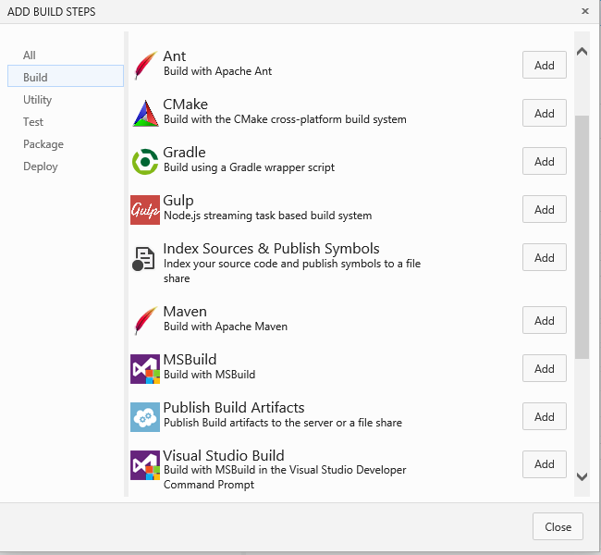
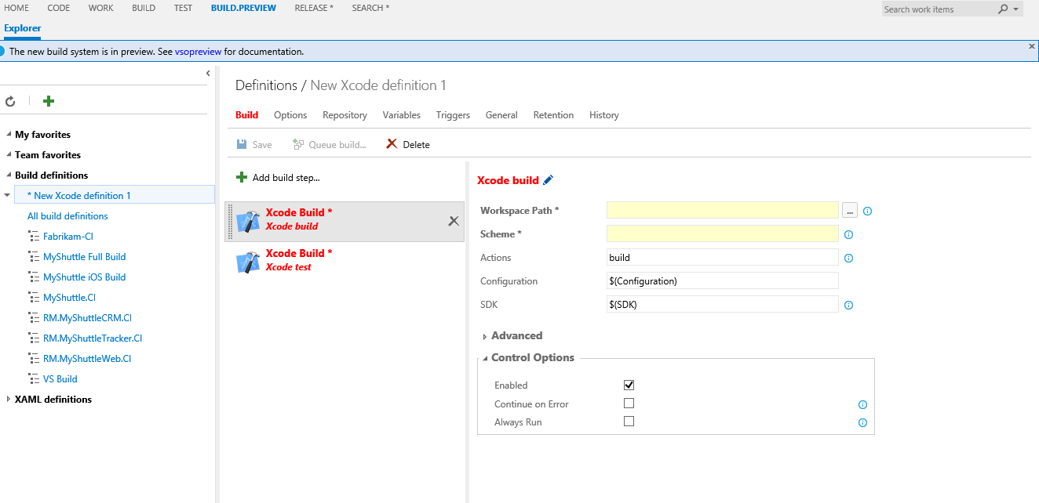
Continuous Integration Obtaining DevOps speed
Reuse your existing Assets – MSBuild, Ant, Make, Maven, Gradle
Support non-windows platforms natively
Extensible Architecture
All OOB Tasks are Open Sourced
Notes:
© 2014 Microsoft Corporation. All rights reserved. Microsoft, Windows, and other product names are or may be registered trademarks and/or trademarks in the U.S. and/or other countries. The information herein is for informational purposes only and represents the current view of Microsoft Corporation as of the date of this presentation. Because Microsoft must respond to changing market conditions, it should not be interpreted to be a commitment on the part of Microsoft, and Microsoft cannot guarantee the accuracy of any information provided after the date of this presentation. MICROSOFT MAKES NO WARRANTIES, EXPRESS, IMPLIED OR STATUTORY, AS TO THE INFORMATION IN THIS PRESENTATION.
10.03.2020
<number>

Slide 24
Test Tools Recap

Slide 25
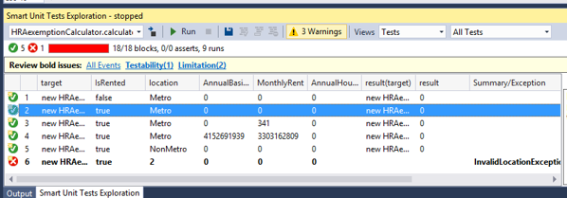
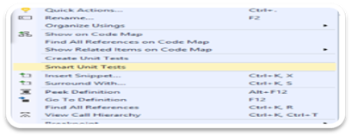
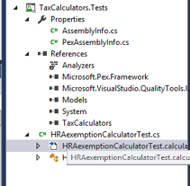
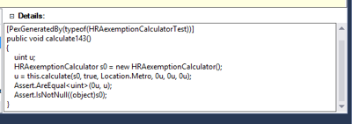
Intellitest Ensuring 100% code coverage
Automatically generates relevant inputs to exercise all code paths
Fully integrated with Visual Studio and Build
Will not “pollute” existing code assets created in separate projects and supplies regression baselines
Supplies Code behaviors Points out test unfriendly code and
Notes:
Consider having to make changes to a body of code which happens to have no test coverage. We might want to pin down its behaviour in terms of a unit test suite before starting, but that is easier said than done. We would face several impediments:
The code (“product code”) might not lend itself to being unit testable.
It might have tight dependencies with the external environment that will need to be isolated, and if we cannot spot them we might not even know where to get started from.
Then there is the quality of the tests. There are many measures of that quality. There is the measure of coverage - how many branches, or code paths, or other program artifacts, in the product code do our tests touch.
There is the measure of assertions expressing “is the code doing the right thing?”. Neither of these measures by themselves is sufficient, however. Instead, it would be nice if we had a high density of assertions being validated with high code coverage.
But it is not easy to do this kind of quality-analyses in our heads as we write the tests and as a consequence we might end up with tests that exercise the same code paths repeatedly; perhaps just testing the “happy path” even, and we will never know if the product code can even cope with all those edge cases.
And frustratingly, we might not even know what assertions to put in - imagine being called upon to make changes to an unfamiliar code base!
Smart Unit Tests tries to address these impediments. It discovers all code paths in your code, synthesizes precise test input values that exercise those code paths, and then records what the output from your code was for the said inputs.
© 2014 Microsoft Corporation. All rights reserved. Microsoft, Windows, and other product names are or may be registered trademarks and/or trademarks in the U.S. and/or other countries. The information herein is for informational purposes only and represents the current view of Microsoft Corporation as of the date of this presentation. Because Microsoft must respond to changing market conditions, it should not be interpreted to be a commitment on the part of Microsoft, and Microsoft cannot guarantee the accuracy of any information provided after the date of this presentation. MICROSOFT MAKES NO WARRANTIES, EXPRESS, IMPLIED OR STATUTORY, AS TO THE INFORMATION IN THIS PRESENTATION.
10.03.2020
<number>

Slide 26
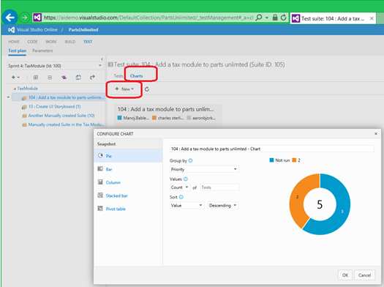



Manual Test Case Management Integrating your Testing and Development efforts
Automatically generates charts, graphs and status reports
Execute Tests on any environment
Easy to create Test Cases en bulk with grid editing and shared parameters
Track quality progress and integrate with the development teams user stories
Notes:
http://blogs.msdn.com/b/visualstudioalm/archive/2014/10/22/new-features-test-management-tools-walk-through.aspx
https://channel9.msdn.com/Blogs/Test-Case-Management-with-Visual-Studio-Online
http://blogs.msdn.com/b/visualstudioalm/archive/2013/02/12/light-weight-browser-based-test-management-and-execution.aspx
© 2014 Microsoft Corporation. All rights reserved. Microsoft, Windows, and other product names are or may be registered trademarks and/or trademarks in the U.S. and/or other countries. The information herein is for informational purposes only and represents the current view of Microsoft Corporation as of the date of this presentation. Because Microsoft must respond to changing market conditions, it should not be interpreted to be a commitment on the part of Microsoft, and Microsoft cannot guarantee the accuracy of any information provided after the date of this presentation. MICROSOFT MAKES NO WARRANTIES, EXPRESS, IMPLIED OR STATUTORY, AS TO THE INFORMATION IN THIS PRESENTATION.
10.03.2020
<number>

Slide 27
Test Tools Now & Going Forward

Slide 28




Test Tools with Web Access
Testing in Visual Studio Team Services
Run and manage any tests with rich reports for summary as well as drill down into test results for analyzing test failures all from simple to use web based interfaces. Load Testing, takes advantage of public cloud elasticity to easily scale load tests and empower teams to address performance issues early in the development process.
Go to
Manual Testing
Go to
Automated Testing
Go to
Load Testing
https://partsunlimited.visualstudio.com/DefaultCollection/Customer/_home/index?Test=JumpStart

Slide 29





Exploratory Testing Validate your development efforts
Easy acquisition
Rich bug filing
Easy getting started
Works on any platform
Works across your devices
Resilient and cross instances
Notes:
© 2014 Microsoft Corporation. All rights reserved. Microsoft, Windows, and other product names are or may be registered trademarks and/or trademarks in the U.S. and/or other countries. The information herein is for informational purposes only and represents the current view of Microsoft Corporation as of the date of this presentation. Because Microsoft must respond to changing market conditions, it should not be interpreted to be a commitment on the part of Microsoft, and Microsoft cannot guarantee the accuracy of any information provided after the date of this presentation. MICROSOFT MAKES NO WARRANTIES, EXPRESS, IMPLIED OR STATUTORY, AS TO THE INFORMATION IN THIS PRESENTATION.
10.03.2020
<number>

Slide 30
Demo
Notes:
Walk through one of the demos at:
http://aka.ms/vstest
© 2014 Microsoft Corporation. All rights reserved. Microsoft, Windows, and other product names are or may be registered trademarks and/or trademarks in the U.S. and/or other countries. The information herein is for informational purposes only and represents the current view of Microsoft Corporation as of the date of this presentation. Because Microsoft must respond to changing market conditions, it should not be interpreted to be a commitment on the part of Microsoft, and Microsoft cannot guarantee the accuracy of any information provided after the date of this presentation. MICROSOFT MAKES NO WARRANTIES, EXPRESS, IMPLIED OR STATUTORY, AS TO THE INFORMATION IN THIS PRESENTATION.
10.03.2020
<number>

Slide 31
Continuous Testing Ensuring Quality at DevOps speed
Run test type of your choice (Unit, Functional, CodedUI, Selenium...etc)
Shared/common architecture with Build(CI) and Release Management(CD)
Simplified provisioning and deploying experience (OnPrem and Cloud)
Distributed Test Execution
Measure Code Coverage
Enable Load Testing as part of your release pipeline
Rich test reports for summary
Drill down in to test results and analyze test failures
Notes:
© 2014 Microsoft Corporation. All rights reserved. Microsoft, Windows, and other product names are or may be registered trademarks and/or trademarks in the U.S. and/or other countries. The information herein is for informational purposes only and represents the current view of Microsoft Corporation as of the date of this presentation. Because Microsoft must respond to changing market conditions, it should not be interpreted to be a commitment on the part of Microsoft, and Microsoft cannot guarantee the accuracy of any information provided after the date of this presentation. MICROSOFT MAKES NO WARRANTIES, EXPRESS, IMPLIED OR STATUTORY, AS TO THE INFORMATION IN THIS PRESENTATION.
10.03.2020
<number>

Slide 32




Testing Java Applications Testing across platforms
Fully integrated into your DevOps Pipelines with the devices and Java Test frameworks you are already using
Full Code Coverage Across your testing efforts
Easily create bugs with errors, stack and automatic linking to your test runs and builds
Highlight build on build regressions for tests, failures and performance
Notes:
https://channel9.msdn.com/Series/Test-Tools-in-Visual-Studio/Testing-Java-Applications-with-Visual-Studio-Team-Services
© 2014 Microsoft Corporation. All rights reserved. Microsoft, Windows, and other product names are or may be registered trademarks and/or trademarks in the U.S. and/or other countries. The information herein is for informational purposes only and represents the current view of Microsoft Corporation as of the date of this presentation. Because Microsoft must respond to changing market conditions, it should not be interpreted to be a commitment on the part of Microsoft, and Microsoft cannot guarantee the accuracy of any information provided after the date of this presentation. MICROSOFT MAKES NO WARRANTIES, EXPRESS, IMPLIED OR STATUTORY, AS TO THE INFORMATION IN THIS PRESENTATION.
10.03.2020
<number>

Slide 33
Demo
Notes:
Walk through one of the demos at:
http://aka.ms/vstest
© 2014 Microsoft Corporation. All rights reserved. Microsoft, Windows, and other product names are or may be registered trademarks and/or trademarks in the U.S. and/or other countries. The information herein is for informational purposes only and represents the current view of Microsoft Corporation as of the date of this presentation. Because Microsoft must respond to changing market conditions, it should not be interpreted to be a commitment on the part of Microsoft, and Microsoft cannot guarantee the accuracy of any information provided after the date of this presentation. MICROSOFT MAKES NO WARRANTIES, EXPRESS, IMPLIED OR STATUTORY, AS TO THE INFORMATION IN THIS PRESENTATION.
10.03.2020
<number>

Slide 34








Cloud-based Load Testing Visual Studio easy and cloud scalable
Enable complex scenarios
Simple to use Web Based Authoring
Application Insights Integration
DevOps Integration
Scalable: 100 cores, 10 locations, 72 Hours 10 Parallel Runs
Load Testing Behind the Firewall
JMeter Support Preview
Pricing
Notes:
The Internet is the great equalizer in the business world. It helps the smallest companies compete with the largest corporations in the world. There is as much opportunity as there is risk. Applications must perform on time all the time. Downtime equates directly to lost revenue. To help development teams understand the performance characteristics of their apps under duress and heavy usage, Microsoft released load testing tools with Visual Studio Team System in 2005.
Even before that release, Visual Studio load testing was one of the most widely internally used test tools. Which begs the question, regardless of the tool used, why didn’t load testing gain the same acceptance by the world at large? Turns out load testing isn’t done by most development teams due to the effort of setting up and managing the infrastructure required.
We would like to say we have now solved that with Load testing in Visual Studio.
With Visual Studio 2013, Microsoft released cloud-based load testing as part of Visual Studio Online. This solves the challenge of using Microsoft Azure to automatically provision and host a load testing infrastructure. With Visual Studio 2013 Update 3, cloud load testing in Visual Studio Online was further enhanced with Application Insights integration. This helps demonstrate internal diagnostics such as performance counters, exceptions and objects allocated during the run. Last November we released the ability to author load tests in an easy to use web experience and in the last couple of sprints have add the capability to run your load test from different locations, scale to 100 cores and have runs 72 hours long…all in in 10 parallel runs (so 1000 cores etc).
© 2014 Microsoft Corporation. All rights reserved. Microsoft, Windows, and other product names are or may be registered trademarks and/or trademarks in the U.S. and/or other countries. The information herein is for informational purposes only and represents the current view of Microsoft Corporation as of the date of this presentation. Because Microsoft must respond to changing market conditions, it should not be interpreted to be a commitment on the part of Microsoft, and Microsoft cannot guarantee the accuracy of any information provided after the date of this presentation. MICROSOFT MAKES NO WARRANTIES, EXPRESS, IMPLIED OR STATUTORY, AS TO THE INFORMATION IN THIS PRESENTATION.
10.03.2020
<number>

Slide 35
Demo
Notes:
Walk through one of the demos at:
http://aka.ms/vstest
© 2014 Microsoft Corporation. All rights reserved. Microsoft, Windows, and other product names are or may be registered trademarks and/or trademarks in the U.S. and/or other countries. The information herein is for informational purposes only and represents the current view of Microsoft Corporation as of the date of this presentation. Because Microsoft must respond to changing market conditions, it should not be interpreted to be a commitment on the part of Microsoft, and Microsoft cannot guarantee the accuracy of any information provided after the date of this presentation. MICROSOFT MAKES NO WARRANTIES, EXPRESS, IMPLIED OR STATUTORY, AS TO THE INFORMATION IN THIS PRESENTATION.
10.03.2020
<number>

Slide 36


Application Monitoring with Application Insights
360° View Across
Availability, Performance & Usage
Overall app health via Overview Blade
Quickly correlate performance & usage data
Detailed insights with a click of a button through intuitive data exploration
Fast & Powerful Diagnostics & Usage Insights
Quickly diagnose availability & performance issues
Learn & improve continuously with usage insights
Extend your telemetry data
Export your data for further analysis
Built-in Analytics
for any app
Supports any app type
Zero-click enablement
No-touch monitoring
Notes:
360° View Across Availability, Performance & Usage
Overall app health via Overview Blade
Quickly correlate performance & usage data
Detailed insights with a click of a button through intuitive data exploration
Fast & Powerful Diagnostics & Usage Insights
Quickly diagnose availability & performance issues
Learn & improve continuously with usage insights
Extend your telemetry data
Export your data for further analysis
Built-in Analytics for any app
Supports any app type
Zero-click enablement
No-touch monitoring
Microsoft Ignite 2015
© 2015 Microsoft Corporation. All rights reserved. MICROSOFT MAKES NO WARRANTIES, EXPRESS, IMPLIED OR STATUTORY, AS TO THE INFORMATION IN THIS PRESENTATION.
10.3.20 01:54 PM
<number>

Slide 37
Thank you!

Slide 38
Agile Planning
The goal for modern application delivery is responsiveness, which relies on flexible scheduling and close collaboration between development and operations to facilitate real-time communication and eliminating wasteful handoffs. Multidisciplinary teams pull from a common product-backlog, minimize work in process, and deliver work ready to deploy live at the end of each sprint.
Plan sprints using team-based capacity planning, assign work by dragging-dropping, and monitor progress throughout the sprint with real-time burndown charts. In addition, each backlog comes with a built-in Kanban board. Customize the columns to suit your workflow, set WIP limits to monitor flow, and drag-and-drop items through the correct columns as you start and finish work.

Slide 39
Continuous Integration
Automated builds are key to eliminating integration issues early. Use gated check-ins to ensure your source code repository only contains architecturally verified, buildable, and analyzed code. Use Team Foundation Server or Visual Studio Online to easily define builds in an intuitive web interface using a rich gallery of reusable and extensible build tasks with support for Ant, Maven and Gradle and the ability run your build agent on Windows, Linux or the Mac.

Slide 40
Continuous Delivery
Gain full visibility, transparency and auditability at every stage of the release pipeline all the way to production. Create automated and repeatable workflows between development and operations that enable applications to be released faster, more frequently while minimizing operational risk.

Slide 41
Continuous Testing
Run any tests on cloud or enterprise environments with a simple task in continuous integration and continuous deployment pipelines. Take advantage of public cloud elasticity to easily scale load tests and empower teams to address performance issues early in the development process. Rich test reports for results summary and also to drill down into test results for analyzing test failures.

Slide 42
Application Monitoring
Get the full picture with customizable dashboards that track application health alongside usage metrics and app crashes. Dashboard views can be filtered, searched, and can drill down to an event instance for more detail or to segment data.
Add Application Insights to Java, Windows, iOS, or Android apps within their respective tools. Monitor apps on web technologies like Ruby, Python, PHP, Node.js, .NET, and more with open source SDKs.

Slide 43




Continuous Delivery Getting the value to the customers
Automate Deployments
Automate the approval workflow
Full Traceability with Release tracking and dashboards
Simple Web UI with a simplified authoring for release definitions
Open and Extensible enabling industry wide Build sources, deployment and testing tools and Clouds
Notes:
© 2014 Microsoft Corporation. All rights reserved. Microsoft, Windows, and other product names are or may be registered trademarks and/or trademarks in the U.S. and/or other countries. The information herein is for informational purposes only and represents the current view of Microsoft Corporation as of the date of this presentation. Because Microsoft must respond to changing market conditions, it should not be interpreted to be a commitment on the part of Microsoft, and Microsoft cannot guarantee the accuracy of any information provided after the date of this presentation. MICROSOFT MAKES NO WARRANTIES, EXPRESS, IMPLIED OR STATUTORY, AS TO THE INFORMATION IN THIS PRESENTATION.
10.03.2020
<number>

Slide 44
Notes (hidden)
Some speakers at Microsoft like to use this slide for hidden “notes slides”.
Delete it if you don’t want to use it.
NEXT: <next slide title>
Notes:
10.3.20 01:54 PM
<number>
© 2010 Microsoft Corporation. All rights reserved. Microsoft, Windows, Windows Vista and other product names are or may be registered trademarks and/or trademarks in the U.S. and/or other countries.
The information herein is for informational purposes only and represents the current view of Microsoft Corporation as of the date of this presentation. Because Microsoft must respond to changing market conditions, it should not be interpreted to be a commitment on the part of Microsoft, and Microsoft cannot guarantee the accuracy of any information provided after the date of this presentation. MICROSOFT MAKES NO WARRANTIES, EXPRESS, IMPLIED OR STATUTORY, AS TO THE INFORMATION IN THIS PRESENTATION.

Slide 45
Speakers, Please Read (hidden slide)
Please consult your Track PM (listed below) for track details and a list of attendees that have added your session to their personal schedule builder calendar.
Track Name, Acronym and Track PM Architecture (ARC) – Sara Mocke, Rene de Freitas Business Analytics (BA) – Matt Goswell, Maxine Coo Business Solutions (MSDY) – Mollie Brodt, Nicole Collet, Sheldon McLaughlin Certification (CRT) – David Elfassy, Veronica Sopher Cloud and Datacenter Platform (CDP) – David Holladay, Gail Johnson, Nanette Heyning Cloud Productivity (CP) – Heather Correa, Nannette Sperling, Michael Kophs Data Platform (DP) – Matt Goswell, Maxine Coo Development Tools & Technologies (DEV) – Beth Massi, Amy Valentine Enterprise Mobility (EM) – Thomas Willingham, Justin Turner, Gail Johnson, Nanette Heyning Innovation WhiteSpace (WS) – Matjaz Ladava, Rene de Freitas Microsoft Azure (AZR) – Peter Walsted, Gail Johnson, Nanette Heyning Modern Service Management (MSM) – Juliet Hossman Security & Privacy (SEC) – Ken Malcolmson Tech Selling in the Enterprise (TSE) – Kirby Drysen, Jerry Lee Universal Communications (UC) – Derek Whittle, Jamie Timperley, Brandi Cook, Katie Calzaretta Windows Operating Systems (WOS) – Paige Langlee, Lisa Puchosic | Virtual Track Name and Track PM Center of Excellence – Ernesto Marquina Data Insights – Robert Skoglund Digital Experiences – J.P. DeCuire HARDCORE – Chris Jackson, Steve Thomas Industry – Ilia Fortunov Internet of Things – Eric Leseberg Linux and OSS – Michael Kelly, Gurpreet Singh User Experience – Alison Clark
Notes:
10.03.2020
© 2012 Microsoft Corporation. All rights reserved. Microsoft, Windows, Windows Vista and other product names are or may be registered trademarks and/or trademarks in the U.S. and/or other countries.
The information herein is for informational purposes only and represents the current view of Microsoft Corporation as of the date of this presentation. Because Microsoft must respond to changing market conditions, it should not be interpreted to be a commitment on the part of Microsoft, and Microsoft cannot guarantee the accuracy of any information provided after the date of this presentation. MICROSOFT MAKES NO WARRANTIES, EXPRESS, IMPLIED OR STATUTORY, AS TO THE INFORMATION IN THIS PRESENTATION.
<number>
TechReady 14

Slide 46
Speakers, Please Read (hidden slide)
In-room Event Detail:
TechReady22 will utilize the new PowerPoint 2016, as well as PowerPoint 2013 on all event machines. Please build your slides utilizing the appropriate TR22 Template and utilize the version of PPT that works best.
PPT Upload Process
Please take the following steps to submit your PPT deck when the deck is final and ready for onsite attendee access via CommNet (the onsite conference network).
Submit Final PPT Decks by 12:00pm PT, Friday 29 January:
Login to your speaker portal at https://www.mytechready.com (you must be registered as a speaker to access the portal)
In the “Session Details” section on the Speaker Portal, click the "Manage Slides” link for each session listed
A new window will open for TechReady22 Slide Deck Management – follow the steps on that page to upload your PPT deck
Once your PPT deck is final, use the same "Manage Slides" link to upload the final deck and then select “Publish to CommNet“. Your deck will then be available to attendees onsite via CommNet. You will also find the deck ready for your session on the PPT computer in your session room
Note: Decks "Published to CommNet" will not be accessible for additional review/comment.
After Friday 29 January, PPT decks must be brought onsite to Silver Fox (the Presentations Group) located in Room 203 at the Washington State Convention Center.
Complete details and resources are available on your speaker portal at https://www.mytechready.com.
Notes:
10.03.2020
© 2012 Microsoft Corporation. All rights reserved. Microsoft, Windows, Windows Vista and other product names are or may be registered trademarks and/or trademarks in the U.S. and/or other countries.
The information herein is for informational purposes only and represents the current view of Microsoft Corporation as of the date of this presentation. Because Microsoft must respond to changing market conditions, it should not be interpreted to be a commitment on the part of Microsoft, and Microsoft cannot guarantee the accuracy of any information provided after the date of this presentation. MICROSOFT MAKES NO WARRANTIES, EXPRESS, IMPLIED OR STATUTORY, AS TO THE INFORMATION IN THIS PRESENTATION.
<number>
Tech Ready 15

Slide 47
SPEAKER RESOURCES
Check out helpful resources available to assist you when creating your presentation!
Go to your speaker portal at https://www.mytechready.com and visit the “Session Details/PowerPoint Templates” section to access:
Presentation Resource Kit – Stocked full of content, graph, and chart slide options (Available at this link or on your Speaker Portal.)
Speaker Training Video – Tips for utilizing Microsoft VID and more
These resources were created by Silver Fox Productions (the TechReady22 Presentations Group) and are also available within the presentations site.

Slide 48
SPEAKER RESOURCES (cont.)
A few great places to start…
Brand Central: A resource for information on the Microsoft brand
https://microsoft.sharepoint.com/teams/BrandCentral/
Microsoft News Center A great place for the latest and greatest
www.microsoft.com/en-us/news
Xbox Wire Media Assets library
http://news.xbox.com/media/
Featured Devices: PC, tablet and phone hardware imagery and marketing materials
https://www.featureddevices.com/
Presentation Resources: Presentation guidelines and PowerPoint templates
https://microsoft.sharepoint.com/teams/BrandCentral/Pages/Presentations.aspx
Respect intellectual property rights
Photography and graphics used in presentations, for both internal and external audiences, must be owned by Microsoft or licensed appropriately.
Microsoft has agreements in place with several stock providers. Contact Media Acquisitions for more information.
Media Acquisitions (mediaacq alias)
www.superstock.com/
www.gettyimages.com/creativeimages/royaltyfree
www.corbisimages.com/stock-photo/royalty-free
Avoid intellectual property theft: Do not use photos or graphics copied from the web in presentations. When in doubt, consult with LCA http://lcaweb/CTP/Copyrights/Third-Party-Content-Use/Pages/default.aspx

Slide 49
ATTENTION: PLEASE READ
Photography and copyright infringement.
Due to copyright laws, please refrain from searching for photography online and utilizing them in your presentations. Using imagery from movies, television, music and pop-culture is illegal, unless purchased from a stock photography site or given expressed written consent from the owner. If you have any questions regarding your imagery please contact Media Acquisitions Inquiries: mediaacq@microsoft.com.
Alternatively, check out the Presentation Resources Kit found on your speaker portal for links to Microsoft owned images and instructions on impactful
photo and illustration usage.
Custom illustrations may be created by Silver Fox Productions;
details also found in the Presentation Resource Kit.

Slide 50

TECHREADY NETWORK
Interact with attendees through Yammer using your Session Hashtag
Log into the TR Yammer Network located at http://Yammer.com/TechReady
Using Session Hashtags - When posting, commenting or asking for feedback on a specific TR22 session, please use the following hashtag format - #TR22*SESSIONCODE*. For example if you would like to comment on ARC305, the session hashtag would be #TR22ARC305
Introduce yourself and post a message using your session hashtag
Add your session hashtag to your slide deck title slide
Notes:
F
© 2015 Microsoft Corporation. All rights reserved. Microsoft, Windows, and other product names are or may be registered trademarks and/or trademarks in the U.S. and/or other countries. The information herein is for informational purposes only and represents the current view of Microsoft Corporation as of the date of this presentation. Because Microsoft must respond to changing market conditions, it should not be interpreted to be a commitment on the part of Microsoft, and Microsoft cannot guarantee the accuracy of any information provided after the date of this presentation. MICROSOFT MAKES NO WARRANTIES, EXPRESS, IMPLIED OR STATUTORY, AS TO THE INFORMATION IN THIS PRESENTATION.
10.03.2020
<number>

Slide 51
Q&A
If you have questions please proceed to the Q&A MICROPHONE located in your session room.
Notes:
Use this slide to explain Q&A to your session attendees. Remind them to use the Q&A microphones found in the session room when asking questions. A second version of this slide is available at the end of the template to project on the screen during actual Q&A.
Note - It is important for attendees to use the Q&A microphone located in the session room:
TechReadyTV recordings cannot capture Q&A unless it is spoken using the microphone
Attendees in the back of the room may not be able to hear a question from someone in the front of the room
SPEAKERS MUST REPEAT THE QUESTIONS IF THE ATTENDEE IS NOT USING THE MICROPHONE
© 2015 Microsoft Corporation. All rights reserved. Microsoft, Windows, and other product names are or may be registered trademarks and/or trademarks in the U.S. and/or other countries. The information herein is for informational purposes only and represents the current view of Microsoft Corporation as of the date of this presentation. Because Microsoft must respond to changing market conditions, it should not be interpreted to be a commitment on the part of Microsoft, and Microsoft cannot guarantee the accuracy of any information provided after the date of this presentation. MICROSOFT MAKES NO WARRANTIES, EXPRESS, IMPLIED OR STATUTORY, AS TO THE INFORMATION IN THIS PRESENTATION.
10.03.2020
<number>

Slide 52
Session Objectives And Takeaways
Session Objective(s):
Session Objective 1
Session Objective 2
Key Takeaway 1
Key Takeaway 2
This slide is required. Do NOT delete.
Please expand notes window at bottom of slide and read. Then Delete this text box.
Notes:
This slide is required. Do NOT delete. This should be the first slide after your Title Slide. This is an important year and we need to arm our attendees with the information they can use to Grow Share! Please ensure that your objectives are SMART (defined below) and that they will enable them to go in and win against the competition to grow share. If you have questions, please contact your Track PM for guidance. We have also posted guidance on writing good objectives, out on the Speaker Portal (https://www.mytechready.com).
This slide should introduce the session by identifying how this information helps the attendee, partners and customers be more successful. Why is this content important?
This slide should call out what’s important about the session (sort of the why should we care, why is this important and how will it help our customers/partners be successful) as well as the key takeaways/objectives associated with the session. Call out what attendees will be able to execute on using the information gained in this session. What will they be able to walk away from this session and execute on with their customers.
Good Objectives should be SMART (specific, measurable, achievable, realistic, time-bound). Focus on the key takeaways and why this information is important to the attendee, our partners and our customers.
Each session has objectives defined and published on www.mytechready.com, please work with your Track PM to call these out here in the slide deck.
If you have questions, please contact your Track PM. See slide 5 in this template for a complete list of Tracks and TPMs.
10.03.2020
© 2012 Microsoft Corporation. All rights reserved. Microsoft, Windows, Windows Vista and other product names are or may be registered trademarks and/or trademarks in the U.S. and/or other countries.
The information herein is for informational purposes only and represents the current view of Microsoft Corporation as of the date of this presentation. Because Microsoft must respond to changing market conditions, it should not be interpreted to be a commitment on the part of Microsoft, and Microsoft cannot guarantee the accuracy of any information provided after the date of this presentation. MICROSOFT MAKES NO WARRANTIES, EXPRESS, IMPLIED OR STATUTORY, AS TO THE INFORMATION IN THIS PRESENTATION.
<number>
Tech Ready 15

Slide 53

Slide palette info
The PowerPoint palette for this template has been built for you and is shown below. Avoid using too many colors in your presentation.
Select the 4th color from the left for subheads and 1st level non-bulleted text color, or wherever “color” text is preferred over the default black/white text
Accent colors 1-6 – (6 Theme Colors to the far right)
Text
Light 2
Accent 1
Accent 2
Accent 3
Accent 4
Accent 5
Accent 6
Use Accent 1 as the main accent color. Use Accent 2 and Accent 3 when additional colors are needed.
Use Accents 4-6 sparingly – only when more colors are necessary.
Notes:
10.03.2020
<number>
© 2014 Microsoft Corporation. All rights reserved. Microsoft, Windows, and other product names are or may be registered trademarks and/or trademarks in the U.S. and/or other countries. The information herein is for informational purposes only and represents the current view of Microsoft Corporation as of the date of this presentation. Because Microsoft must respond to changing market conditions, it should not be interpreted to be a commitment on the part of Microsoft, and Microsoft cannot guarantee the accuracy of any information provided after the date of this presentation. MICROSOFT MAKES NO WARRANTIES, EXPRESS, IMPLIED OR STATUTORY, AS TO THE INFORMATION IN THIS PRESENTATION.

Slide 54
Preferred text layout (no bullets)
Main topic 1: size 40pt
Size 20pt for the subtopics
Size 20pt for the subtopics
Main topic 2: size 40pt
Size 20pt for the subtopics
Size 20pt for the subtopics
Main topic 3: size 40pt
Size 20pt for the subtopics
Size 20pt for the subtopics
Notes:
10.03.2020
<number>
© 2014 Microsoft Corporation. All rights reserved. Microsoft, Windows, and other product names are or may be registered trademarks and/or trademarks in the U.S. and/or other countries. The information herein is for informational purposes only and represents the current view of Microsoft Corporation as of the date of this presentation. Because Microsoft must respond to changing market conditions, it should not be interpreted to be a commitment on the part of Microsoft, and Microsoft cannot guarantee the accuracy of any information provided after the date of this presentation. MICROSOFT MAKES NO WARRANTIES, EXPRESS, IMPLIED OR STATUTORY, AS TO THE INFORMATION IN THIS PRESENTATION.

Slide 55
Text layout with bullets
Main topic 1: size 40pt
Size 24pt for the subtopics
Size 24pt for the subtopics
Main topic 2: size 40pt
Size 24pt for the subtopics
Size 24pt for the subtopics
Main topic 3: size 40pt
Size 24pt for the subtopics
Size 24pt for the subtopics
Notes:
10.03.2020
<number>
© 2014 Microsoft Corporation. All rights reserved. Microsoft, Windows, and other product names are or may be registered trademarks and/or trademarks in the U.S. and/or other countries. The information herein is for informational purposes only and represents the current view of Microsoft Corporation as of the date of this presentation. Because Microsoft must respond to changing market conditions, it should not be interpreted to be a commitment on the part of Microsoft, and Microsoft cannot guarantee the accuracy of any information provided after the date of this presentation. MICROSOFT MAKES NO WARRANTIES, EXPRESS, IMPLIED OR STATUTORY, AS TO THE INFORMATION IN THIS PRESENTATION.

Slide 56
Bullet points layout with Subhead Subhead
Example of a bulleted slide with a subhead
Set the slide title to “Sentence case”
Set subheads to “Sentence case”
In “bulleted” slide layouts, level 2 text is 24pt
Level 3 text is 24 pt
Level 4 text is 20pt
Level 5 text is 20pt
Hyperlink style
www.microsoft.com
Notes:
<number>
10.03.2020
© 2014 Microsoft Corporation. All rights reserved. Microsoft, Windows, and other product names are or may be registered trademarks and/or trademarks in the U.S. and/or other countries. The information herein is for informational purposes only and represents the current view of Microsoft Corporation as of the date of this presentation. Because Microsoft must respond to changing market conditions, it should not be interpreted to be a commitment on the part of Microsoft, and Microsoft cannot guarantee the accuracy of any information provided after the date of this presentation. MICROSOFT MAKES NO WARRANTIES, EXPRESS, IMPLIED OR STATUTORY, AS TO THE INFORMATION IN THIS PRESENTATION.

Slide 57
Software code slide
This slide layout uses Consolas, a monotype font which is ideal for showing software code.
Notes:
<number>
10.03.2020
© 2014 Microsoft Corporation. All rights reserved. Microsoft, Windows, and other product names are or may be registered trademarks and/or trademarks in the U.S. and/or other countries. The information herein is for informational purposes only and represents the current view of Microsoft Corporation as of the date of this presentation. Because Microsoft must respond to changing market conditions, it should not be interpreted to be a commitment on the part of Microsoft, and Microsoft cannot guarantee the accuracy of any information provided after the date of this presentation. MICROSOFT MAKES NO WARRANTIES, EXPRESS, IMPLIED OR STATUTORY, AS TO THE INFORMATION IN THIS PRESENTATION.

Slide 58
In Review: Session Objectives And Takeaways
Session Objective(s):
Session Objective 1
Session Objective 2
Key Takeaway 1
Key Takeaway 2
This slide is required. Do NOT delete.
Please expand notes window at bottom of slide and read. Then Delete this text box.
Notes:
This slide is recommended as a final slide to recap the objectives of the session to remind attendees what you said would be covered and to highlight that you did indeed cover those points. The objectives listed on this slide should match the objectives covered on the required Objective slide at the beginning of your presentation.
If you have questions, please contact your Track PM. See slide 5 in this template for a complete list of Tracks and TPMs.
10.03.2020
© 2012 Microsoft Corporation. All rights reserved. Microsoft, Windows, Windows Vista and other product names are or may be registered trademarks and/or trademarks in the U.S. and/or other countries.
The information herein is for informational purposes only and represents the current view of Microsoft Corporation as of the date of this presentation. Because Microsoft must respond to changing market conditions, it should not be interpreted to be a commitment on the part of Microsoft, and Microsoft cannot guarantee the accuracy of any information provided after the date of this presentation. MICROSOFT MAKES NO WARRANTIES, EXPRESS, IMPLIED OR STATUTORY, AS TO THE INFORMATION IN THIS PRESENTATION.
<number>
Tech Ready 15

Slide 59
Related Content
Breakout Sessions/Chalk Talks
Session Codes and Titles
Instructor-led Labs
Session Codes and Titles
Hands-on Labs
Hands-on Lab Codes and Titles
TechReady Talks
Session Codes and Titles
Competitive Content
Competitive Content related to your topic area (Session Codes and Titles)
Please expand notes window at bottom of slide and read. Then Delete this text box.
Notes:
Speakers should use this slide to identify content, related to their presentation, being offered in other sessions or labs at TechReady.
Your Track PM can provide a full listing of all of the sessions, hands-on labs, Instructor-led Labs and TechReady Talks in your track, as well as the other tracks.
If there is additional content available that attendees should know about, please add a section for Additional Resources to the slide. In this section you can call out whitepapers or websites that you and your team have created.
If you have questions, please contact your Track PM. See slide 5 in this template for a complete list of Tracks and TPMs.
10.03.2020
© 2012 Microsoft Corporation. All rights reserved. Microsoft, Windows, Windows Vista and other product names are or may be registered trademarks and/or trademarks in the U.S. and/or other countries.
The information herein is for informational purposes only and represents the current view of Microsoft Corporation as of the date of this presentation. Because Microsoft must respond to changing market conditions, it should not be interpreted to be a commitment on the part of Microsoft, and Microsoft cannot guarantee the accuracy of any information provided after the date of this presentation. MICROSOFT MAKES NO WARRANTIES, EXPRESS, IMPLIED OR STATUTORY, AS TO THE INFORMATION IN THIS PRESENTATION.
<number>
Tech Ready 15

Slide 60
Please Complete An Evaluation Form Your input is important!
Multiple ways to access Online Evaluation Forms:
CommNet stations located throughout conference venues
Via both TechReady Windows Phone and Windows 10 Event Apps
Via traditional TechReady Schedule Builder Windows Phone 8.x Application
Via BYOD browser from any wired or wireless internet connection to https://www.MyTechReady.com
For more information, please refer to CommNet
Please expand notes window at bottom of slide and read. Then Delete this text box.
Speaker – Click Here to Launch Video
Notes:
Speakers: The Launch Video button is not activated at this time. Please note this slide will be exchanged for the actual evaluation slide onsite when it will be linked to videos designed to encourage attendees to complete their evals. During your session, the evaluation video needs to be activated by you clicking on the launch video button on this slide.
10.03.2020
© 2012 Microsoft Corporation. All rights reserved. Microsoft, Windows, Windows Vista and other product names are or may be registered trademarks and/or trademarks in the U.S. and/or other countries.
The information herein is for informational purposes only and represents the current view of Microsoft Corporation as of the date of this presentation. Because Microsoft must respond to changing market conditions, it should not be interpreted to be a commitment on the part of Microsoft, and Microsoft cannot guarantee the accuracy of any information provided after the date of this presentation. MICROSOFT MAKES NO WARRANTIES, EXPRESS, IMPLIED OR STATUTORY, AS TO THE INFORMATION IN THIS PRESENTATION.
<number>
Tech Ready 15

Slide 61
Q&A
If you have questions please proceed to the Q&A MICROPHONE located in your session room.
Notes:
Note - It is important for attendees to use the Q&A microphone located in the session room:
TechReadyTV recordings cannot capture Q&A unless it is spoken using the microphone
Attendees in the back of the room may not be able to hear a question from someone in the front of the room
SPEAKERS MUST REPEAT THE QUESTIONS IF THE ATTENDEE IS NOT USING THE MICROPHONE
© 2015 Microsoft Corporation. All rights reserved. Microsoft, Windows, and other product names are or may be registered trademarks and/or trademarks in the U.S. and/or other countries. The information herein is for informational purposes only and represents the current view of Microsoft Corporation as of the date of this presentation. Because Microsoft must respond to changing market conditions, it should not be interpreted to be a commitment on the part of Microsoft, and Microsoft cannot guarantee the accuracy of any information provided after the date of this presentation. MICROSOFT MAKES NO WARRANTIES, EXPRESS, IMPLIED OR STATUTORY, AS TO THE INFORMATION IN THIS PRESENTATION.
10.03.2020
<number>

Slide 62

© 2016 Microsoft Corporation. All rights reserved. Microsoft, Windows, and other product names are or may be registered trademarks and/or trademarks in the U.S. and/or other countries.
The information herein is for informational purposes only and represents the current view of Microsoft Corporation as of the date of this presentation. Because Microsoft must respond to changing market conditions, it should not be interpreted to be a commitment on the part of Microsoft, and Microsoft cannot guarantee the accuracy of any information provided after the date of this presentation. MICROSOFT MAKES NO WARRANTIES, EXPRESS, IMPLIED OR STATUTORY, AS TO THE INFORMATION IN THIS PRESENTATION.
Notes:
10.03.2020
<number>
© 2014 Microsoft Corporation. All rights reserved. Microsoft, Windows, and other product names are or may be registered trademarks and/or trademarks in the U.S. and/or other countries. The information herein is for informational purposes only and represents the current view of Microsoft Corporation as of the date of this presentation. Because Microsoft must respond to changing market conditions, it should not be interpreted to be a commitment on the part of Microsoft, and Microsoft cannot guarantee the accuracy of any information provided after the date of this presentation. MICROSOFT MAKES NO WARRANTIES, EXPRESS, IMPLIED OR STATUTORY, AS TO THE INFORMATION IN THIS PRESENTATION.

Slide 63
Special content slide layouts
Notes:
10.03.2020
<number>
© 2014 Microsoft Corporation. All rights reserved. Microsoft, Windows, and other product names are or may be registered trademarks and/or trademarks in the U.S. and/or other countries. The information herein is for informational purposes only and represents the current view of Microsoft Corporation as of the date of this presentation. Because Microsoft must respond to changing market conditions, it should not be interpreted to be a commitment on the part of Microsoft, and Microsoft cannot guarantee the accuracy of any information provided after the date of this presentation. MICROSOFT MAKES NO WARRANTIES, EXPRESS, IMPLIED OR STATUTORY, AS TO THE INFORMATION IN THIS PRESENTATION.

Slide 64
Section title
Notes:
10.03.2020
<number>
© 2014 Microsoft Corporation. All rights reserved. Microsoft, Windows, and other product names are or may be registered trademarks and/or trademarks in the U.S. and/or other countries. The information herein is for informational purposes only and represents the current view of Microsoft Corporation as of the date of this presentation. Because Microsoft must respond to changing market conditions, it should not be interpreted to be a commitment on the part of Microsoft, and Microsoft cannot guarantee the accuracy of any information provided after the date of this presentation. MICROSOFT MAKES NO WARRANTIES, EXPRESS, IMPLIED OR STATUTORY, AS TO THE INFORMATION IN THIS PRESENTATION.

Slide 65
Section title
Notes:
10.03.2020
<number>
© 2014 Microsoft Corporation. All rights reserved. Microsoft, Windows, and other product names are or may be registered trademarks and/or trademarks in the U.S. and/or other countries. The information herein is for informational purposes only and represents the current view of Microsoft Corporation as of the date of this presentation. Because Microsoft must respond to changing market conditions, it should not be interpreted to be a commitment on the part of Microsoft, and Microsoft cannot guarantee the accuracy of any information provided after the date of this presentation. MICROSOFT MAKES NO WARRANTIES, EXPRESS, IMPLIED OR STATUTORY, AS TO THE INFORMATION IN THIS PRESENTATION.

Slide 66
Demo
Name
Notes:
10.03.2020
<number>
© 2014 Microsoft Corporation. All rights reserved. Microsoft, Windows, and other product names are or may be registered trademarks and/or trademarks in the U.S. and/or other countries. The information herein is for informational purposes only and represents the current view of Microsoft Corporation as of the date of this presentation. Because Microsoft must respond to changing market conditions, it should not be interpreted to be a commitment on the part of Microsoft, and Microsoft cannot guarantee the accuracy of any information provided after the date of this presentation. MICROSOFT MAKES NO WARRANTIES, EXPRESS, IMPLIED OR STATUTORY, AS TO THE INFORMATION IN THIS PRESENTATION.

Slide 67
Video
Notes:
10.03.2020
<number>
© 2014 Microsoft Corporation. All rights reserved. Microsoft, Windows, and other product names are or may be registered trademarks and/or trademarks in the U.S. and/or other countries. The information herein is for informational purposes only and represents the current view of Microsoft Corporation as of the date of this presentation. Because Microsoft must respond to changing market conditions, it should not be interpreted to be a commitment on the part of Microsoft, and Microsoft cannot guarantee the accuracy of any information provided after the date of this presentation. MICROSOFT MAKES NO WARRANTIES, EXPRESS, IMPLIED OR STATUTORY, AS TO THE INFORMATION IN THIS PRESENTATION.

Slide 68
There are over 1 million words in the English language.
Notes:
10.03.2020
<number>
© 2014 Microsoft Corporation. All rights reserved. Microsoft, Windows, and other product names are or may be registered trademarks and/or trademarks in the U.S. and/or other countries. The information herein is for informational purposes only and represents the current view of Microsoft Corporation as of the date of this presentation. Because Microsoft must respond to changing market conditions, it should not be interpreted to be a commitment on the part of Microsoft, and Microsoft cannot guarantee the accuracy of any information provided after the date of this presentation. MICROSOFT MAKES NO WARRANTIES, EXPRESS, IMPLIED OR STATUTORY, AS TO THE INFORMATION IN THIS PRESENTATION.

Slide 69
“ Add a quote here. Design is easier than it looks, and more important than it seems.”
Author’s Name
Notes:
10.03.2020
<number>
© 2014 Microsoft Corporation. All rights reserved. Microsoft, Windows, and other product names are or may be registered trademarks and/or trademarks in the U.S. and/or other countries. The information herein is for informational purposes only and represents the current view of Microsoft Corporation as of the date of this presentation. Because Microsoft must respond to changing market conditions, it should not be interpreted to be a commitment on the part of Microsoft, and Microsoft cannot guarantee the accuracy of any information provided after the date of this presentation. MICROSOFT MAKES NO WARRANTIES, EXPRESS, IMPLIED OR STATUTORY, AS TO THE INFORMATION IN THIS PRESENTATION.

